Slide 1
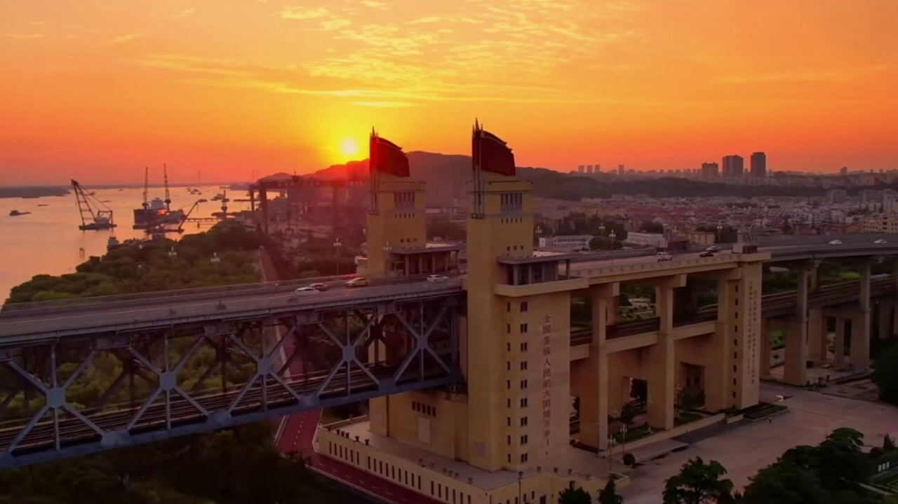

Slide 2
Where can you see these places in the video ?
I can see them in _________
Nanjing
city
Nanjing is our ______.
How is our city in the video?
nice
clean
tidy ...
beautiful
干净的
modern
现代的

Slide 3
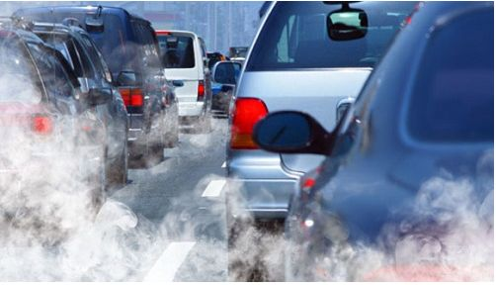
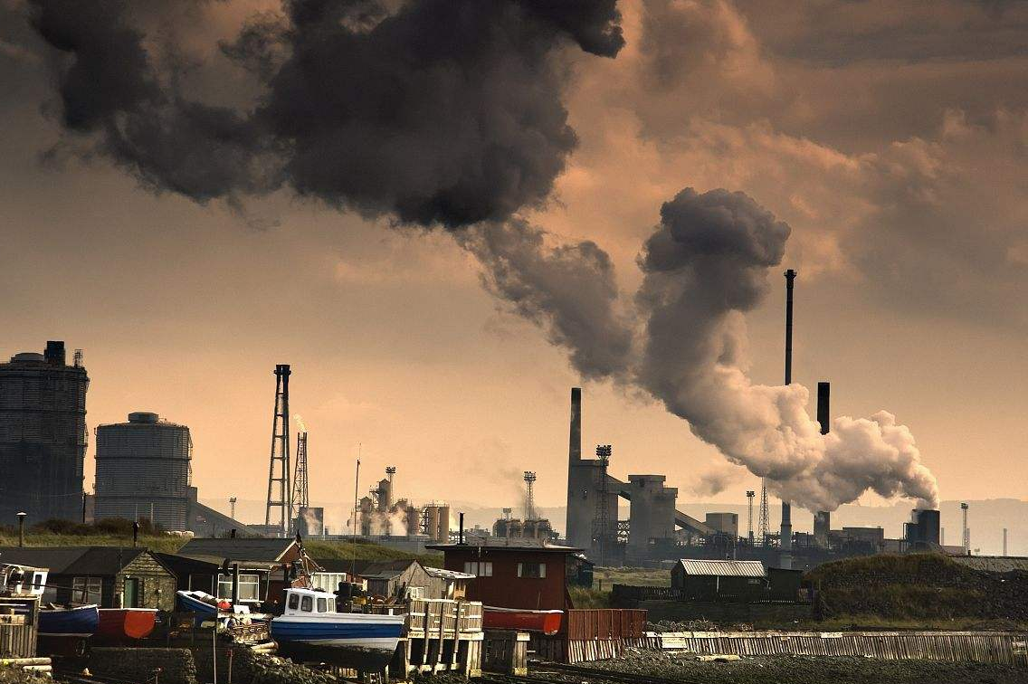
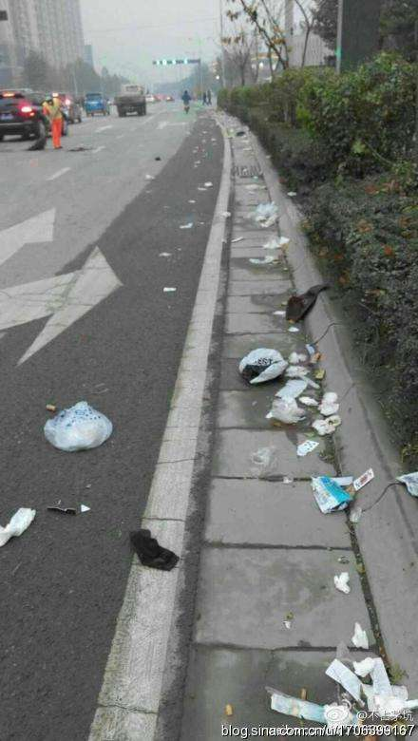
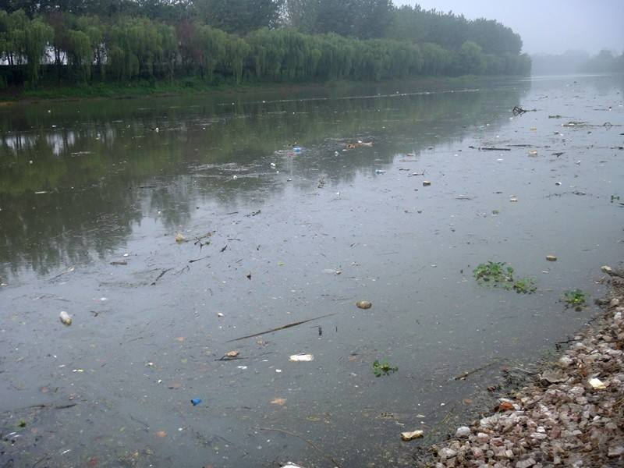
dirty
The old pictures of our city
dirty
['dɜːtɪ]
肮脏的
messy
messy
Was our city clean?
[ 'mesɪ]
乱七八糟的
We should keep our city _______ .
clean

Slide 4
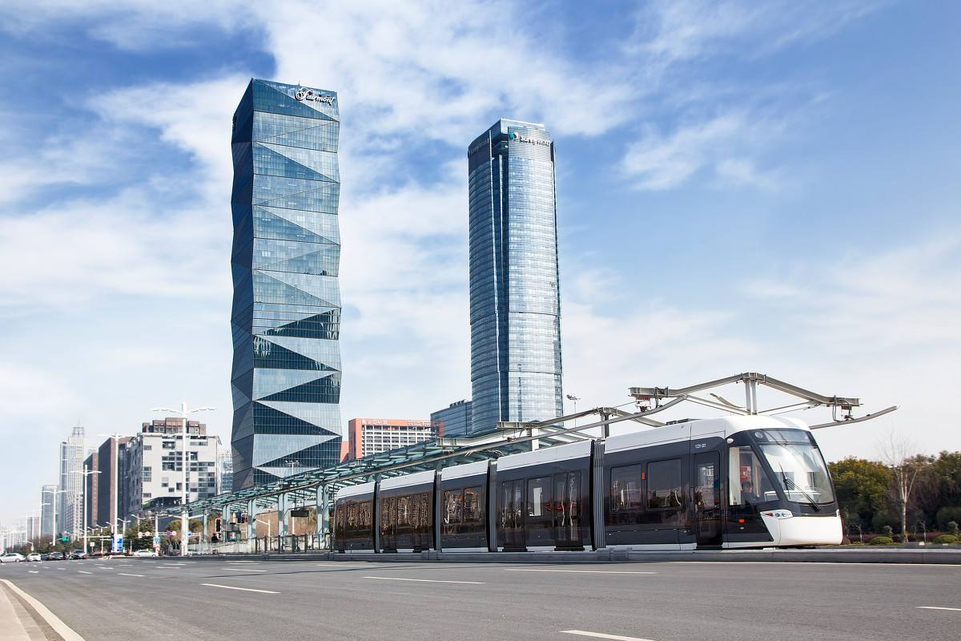
Unit 6
Keep our city clean
保持我们的城市干净

Slide 5




Goals for the lesson
Very good
Good
Come on
To know what made the city messy and dirty. 知道什么使城市变得又脏又乱。
To know how to keep our city clean. 知道怎样能保持我们的城市干净。
To know how to use “make”, “keep” and “can”. 会使用“使得”、“保持”和“可以”。

Slide 6
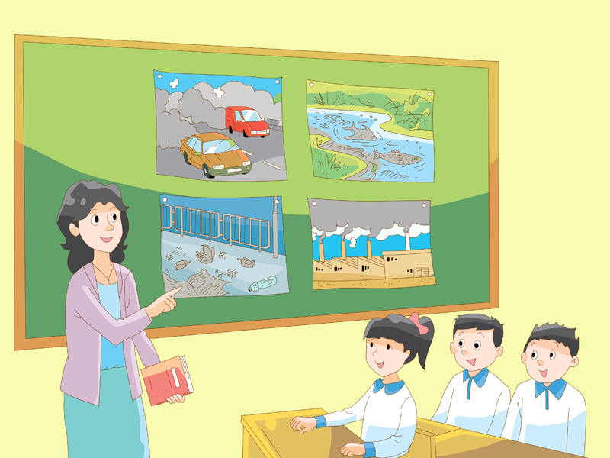
Miss Li and her students are talking about their city too.

Slide 7
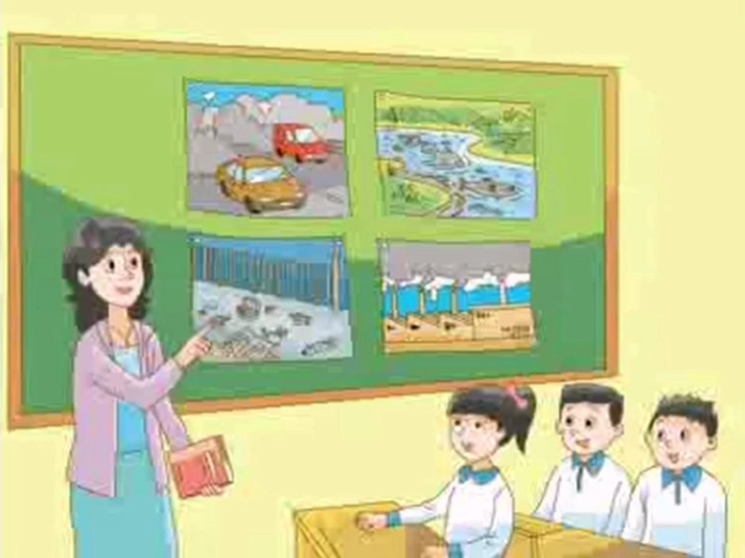
How to keep our city clean?
There are two main questions in the dialogue.

Slide 8
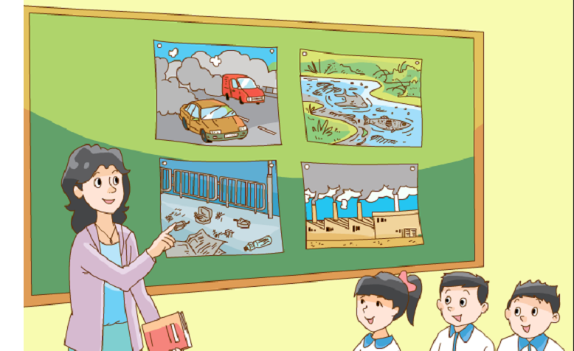

How to keep our city clean?
There are two main questions in the dialogue.
1
What made our city dirty?
什么使我们的城市变脏？
2
What can we do to keep it clean?
我们可以做什么来让我们的城市保持整洁？

Slide 9


Watch and choose
What made the city dirty?
A. Smoke B. Noise C. Rubbish
烟雾
噪音
垃圾

Slide 11
Watch and choose
What made the city dirty?
A. Smoke B. Noise C. Rubbish
A. Smoke C. Rubbish

Slide 12
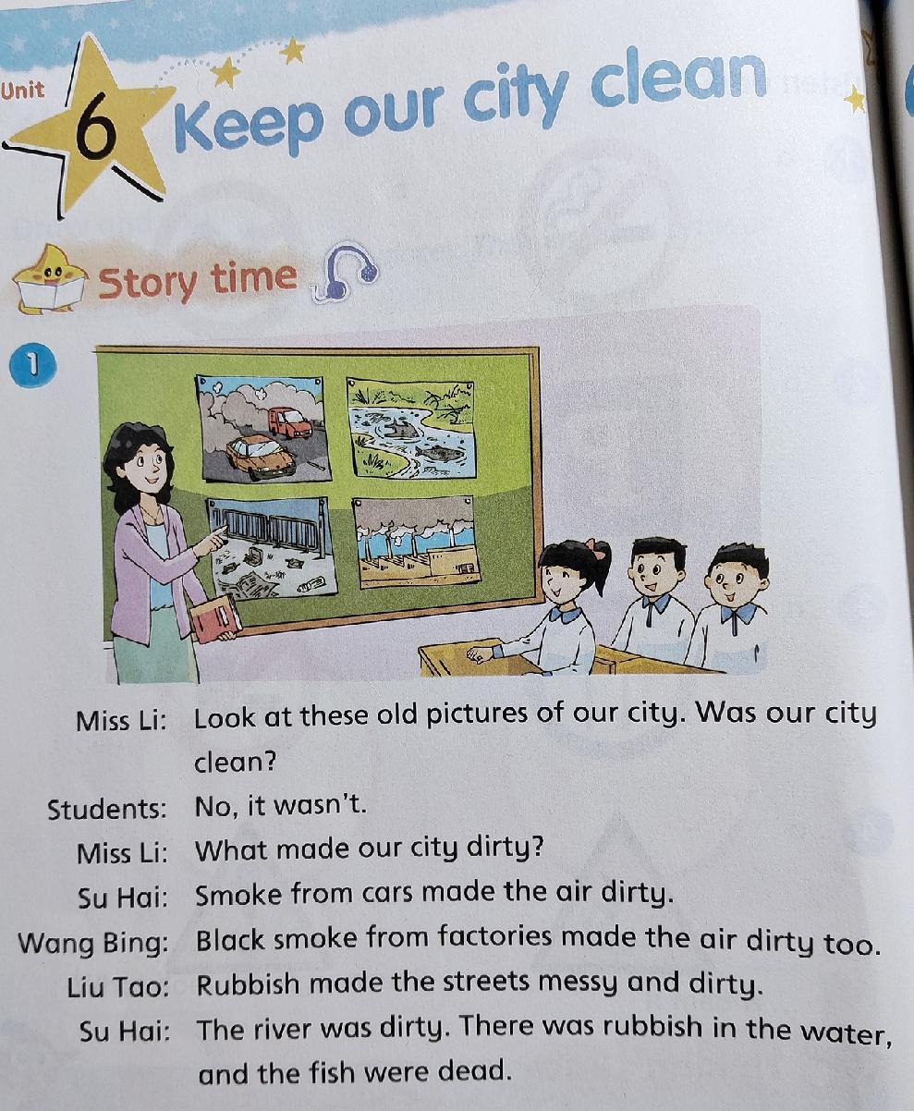

Read and underline
What made the air dirty?
空气
Read part 1 on P58 and underline the answer.
两人一组，大声读课本58页的对话，在正确
答案下面划线。
Tip
遇到生词时，你可以
1 查看P94单词表;
2 请教会的同学；
3 举手问老师。

Slide 13
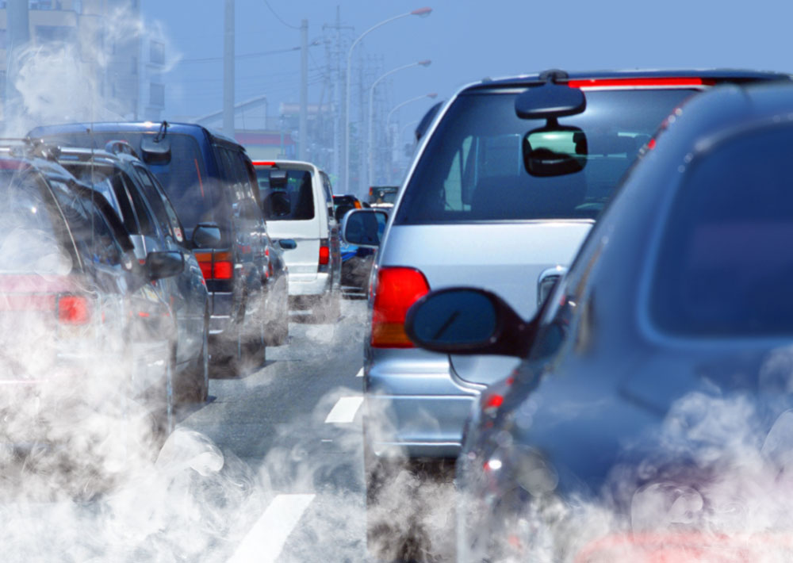
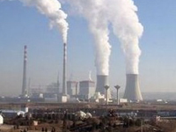
What made the air dirty?
Read and answer
Smoke from cars made the air dirty.
汽车排放的尾气
Black smoke from factories made the air dirty.
工厂排放的黑色废气
factory 工厂

Slide 14
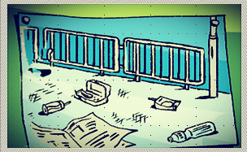
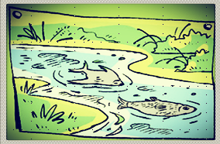
Read and complete
Read part 1 on P58 again and complete the exercise.自己再读一遍58页对话，完成练习一。
the streets messy
and dirty.
Rubbish made…
the river dirty.
the fish dead(死的).

Slide 15
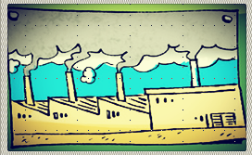
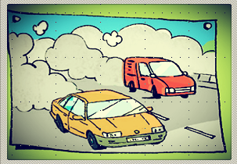

Read part 2 on P59
（自读59页对话）
Read and discuss
What can we do to keep our city clean ?
保持我们的城市干净
你们有什么保护环境的好主意吗？
小组讨论，用We can…说一说吧。

Slide 16
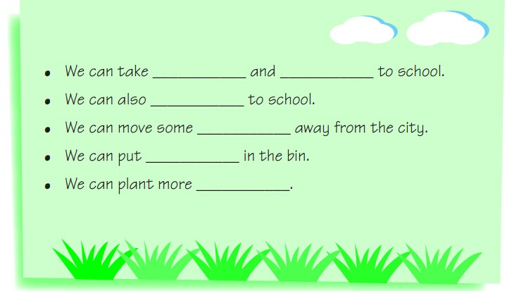
Read and complete
再次读P59对话，完成P60练习。
What can we do to keep the city clean ?
the bus
the metro
walk
factories
rubbish
trees
bin 垃圾桶
plant =grow 种植
more 更多的

Slide 17

Reading Time

Slide 18
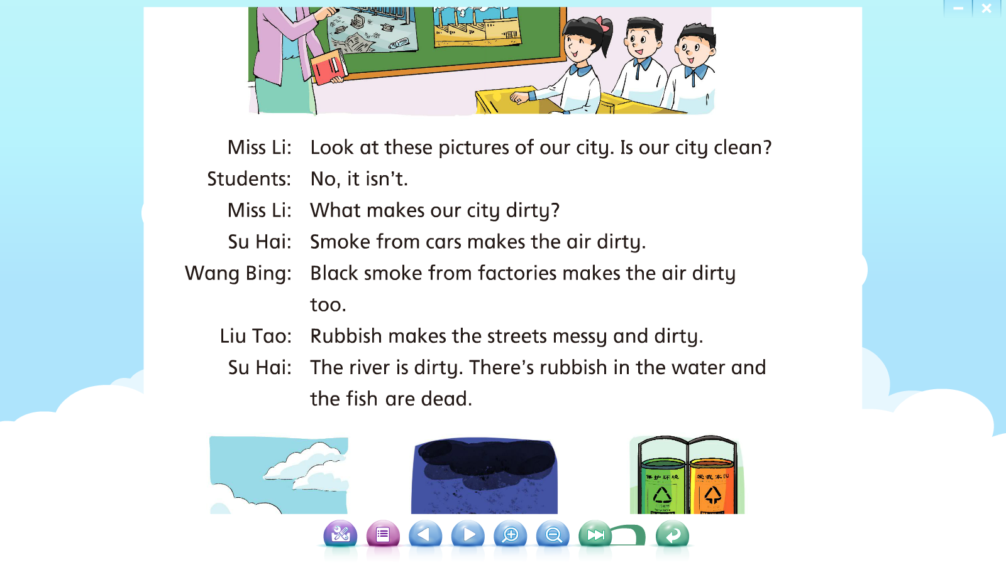
1
Tip:跟读录音时注意重读
Look at these old pictures of our city. Was our city clean?
No, it wasn’t.
What made our city dirty?
Smoke from cars made the air dirty?
Black smoke from factories made the air dirty too?
Rubbish made the streets messy and dirty.
The river was dirty. There was rubbish in the water, and the fish were dead.

Slide 19
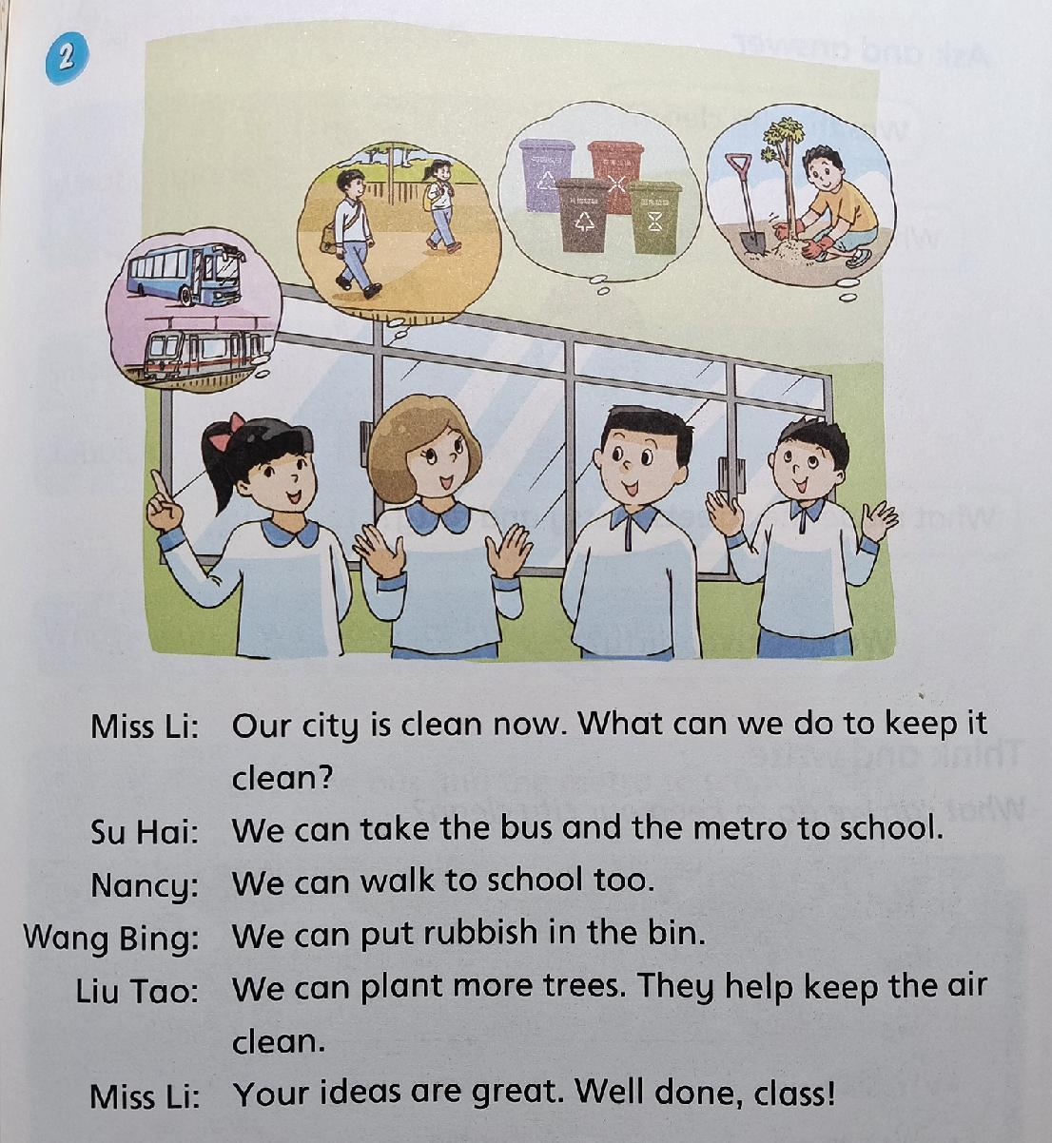
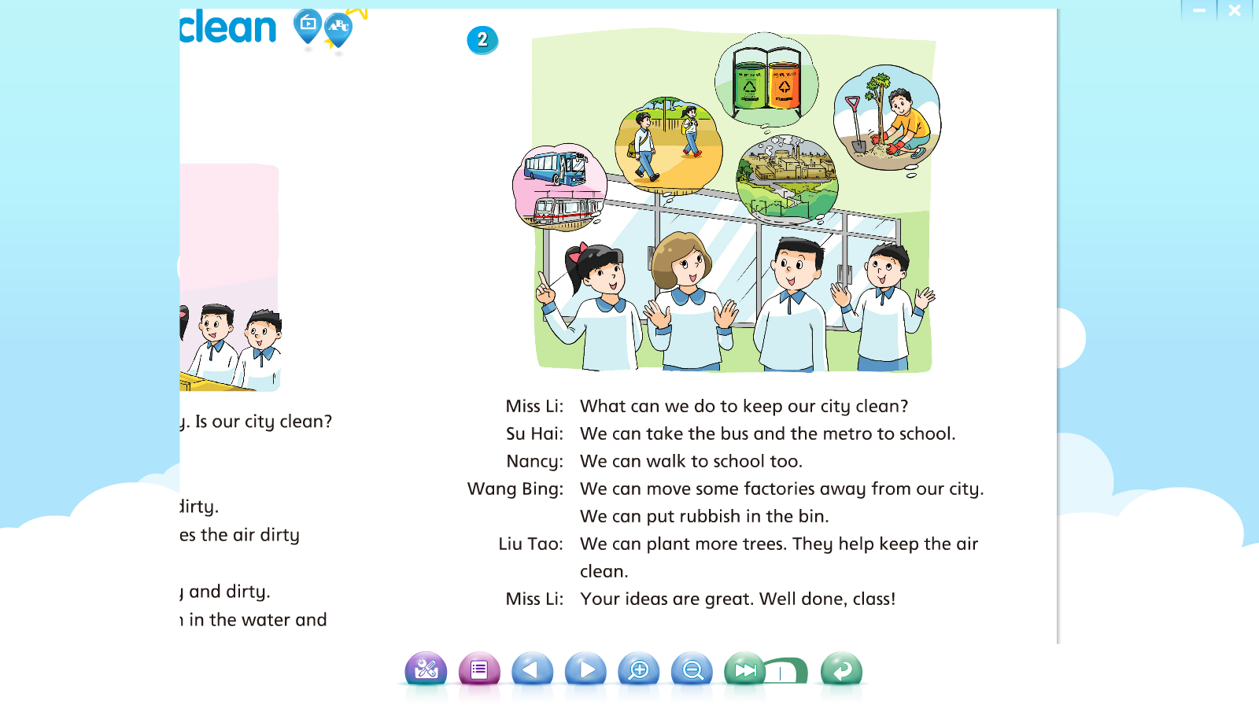
2
Tip:跟读录音时注意重读
升调
降调
Our city is clean now. What can we do to keep it clean?

Slide 20


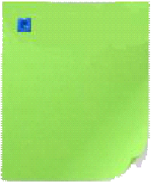
五人一组，选择一种喜欢的方式读一读课文。
Reading time
Read in roles.
(分角色读)
Read together.(齐读)
A: Miss Li
B: Su Hai
C: Nancy
D: Wang Bing
E: Liu Tao

Slide 21
根据课文内容填空，完成练习二。
Fill in the blanks
Today Miss Li and her students are talking about their city. Their city was ____.
____from the cars and factories ____ the air dirty.______ made the street___________ and the fish ____.
The students have some good ideas. They can___ the bus and the ____ to school.They can to school too. They can also ____the rubbish in the bins and ____ more trees to____ the city clean.
dirty
Smoke
made
Rubbish
messy and dirty
dead
take
metro
walk
put
plant
keep

Slide 22

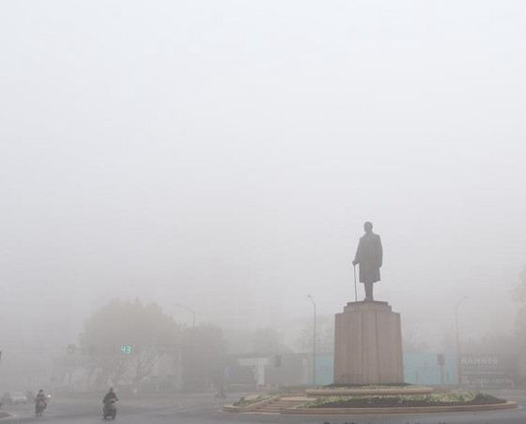
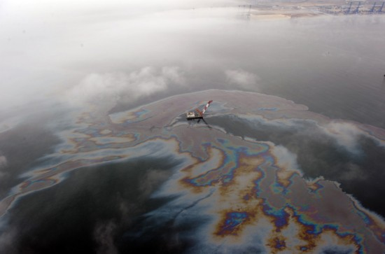
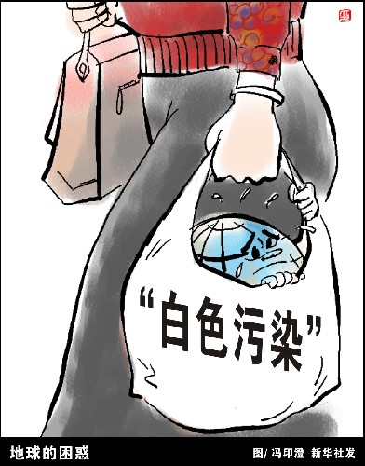
What else made the city dirty ?
smog
雾霾
dirty oil
污油
plastic bags
塑料袋
…

Slide 23
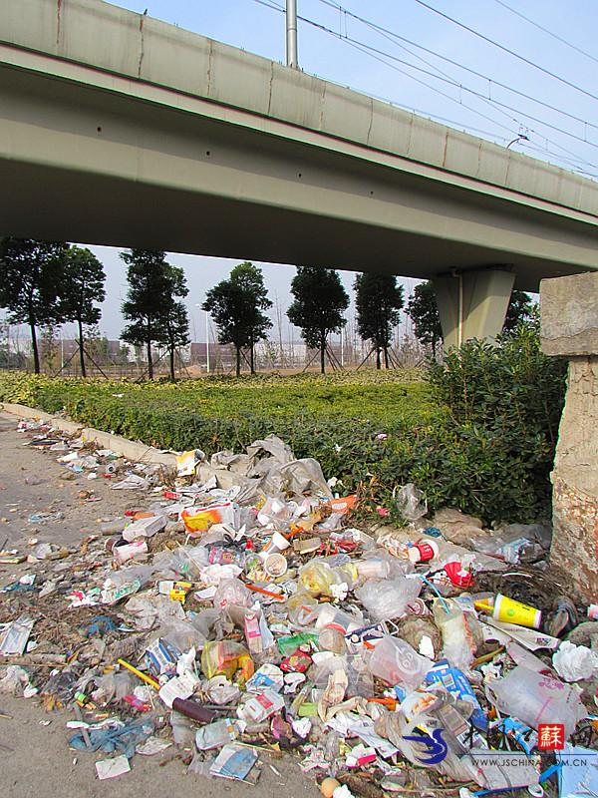
Ask and answer
A: Was the city clean?
B: No, it was …
A: What made the …dirty?
B:…made the … messy/dirty.
A:What can we do to keep our city clean?
B:We can…

Slide 24
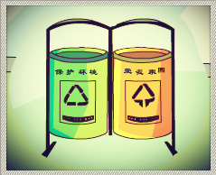
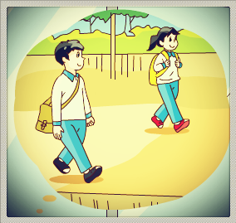
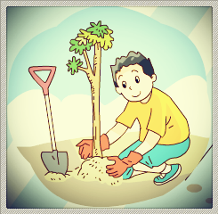
两人一组，选择其中的一幅图用以下句型问答。
Ask and answer
A: Was the city clean?
B: No, it was …
A: What made the …dirty?
B:…made the … messy/dirty.
A:What can we do to keep our city clean?
B:We can…

Slide 25


在心愿卡上用所给句型写出你的环保建议，
贴到希望之树上，为环保尽一份力！
Make a wish card
…made the …dirty/messy/smelly(难闻的)…
We can/should…to keep our city clean.
Disposable chopsticks
(一次性筷子) made the city
dirty. We should use bamboo
chopsticks(竹筷子) and plant
trees to keep our city clean.
A tree of hope
希望之树

Slide 26


Please keep our city clean!
Better city, better life.
城市让生活更美好。

Slide 27


Well done!
Very good
Good
Come on
To know what made the city messy and dirty. 知道什么使城市变得又脏又乱。
To know how to keep our city clean. 知道怎样能保持我们的城市干净。
To know how to use “make”, “keep” and “can”. 会使用“使得”、“保持”和“可以”。
How many stars
can you get?
你们能得到多少颗星？

Slide 28

Homework
1、 Read and retell the story .
2、Finish the exercise of Unit
6 Period 1.(课课练第一课时)

