Slide 1
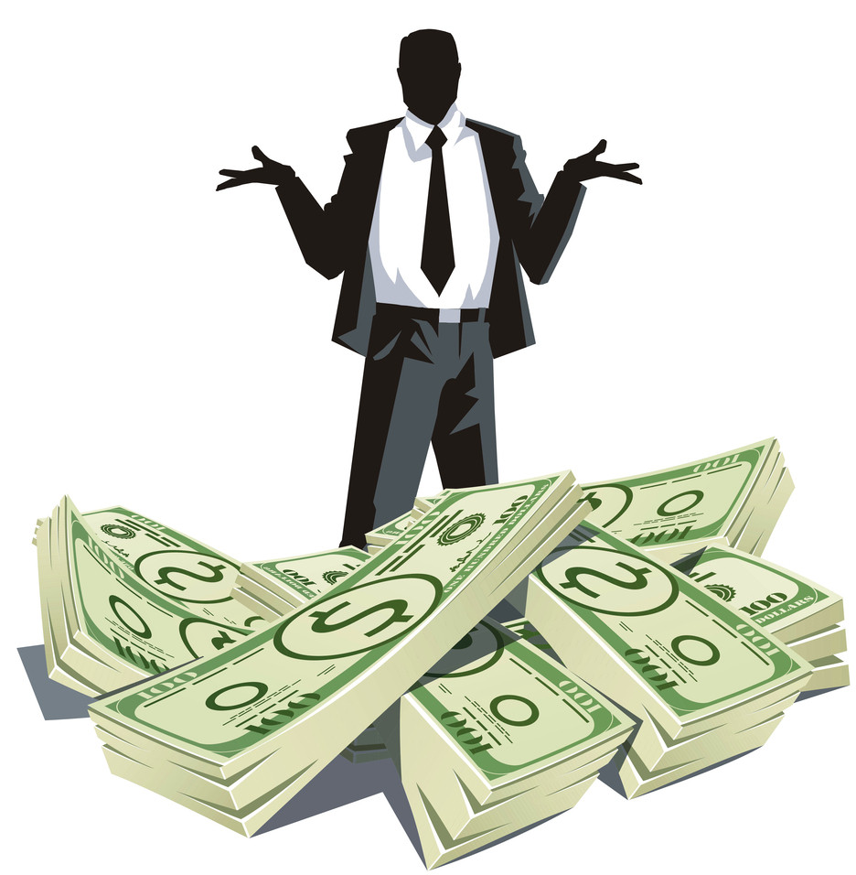
Unit 7 How much？
(Story time)

Slide 2
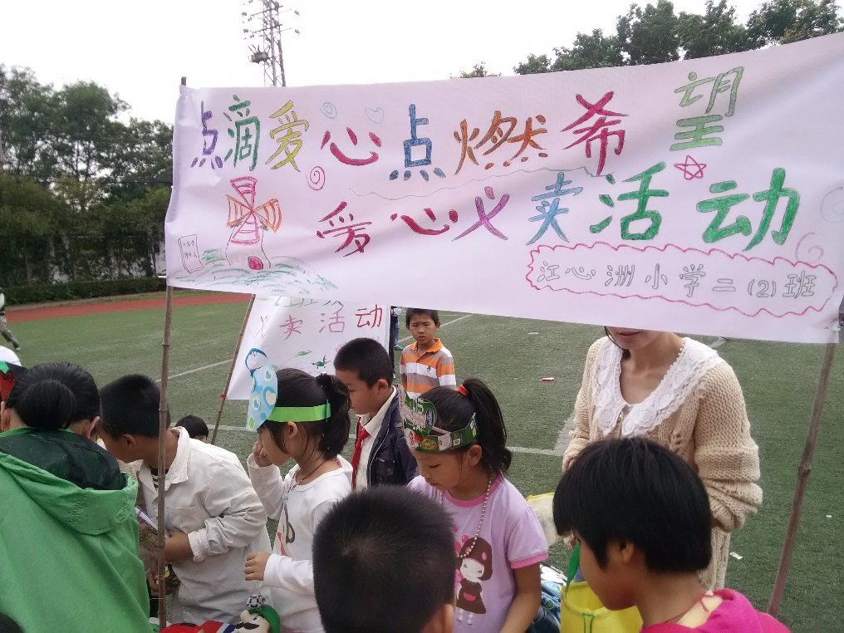
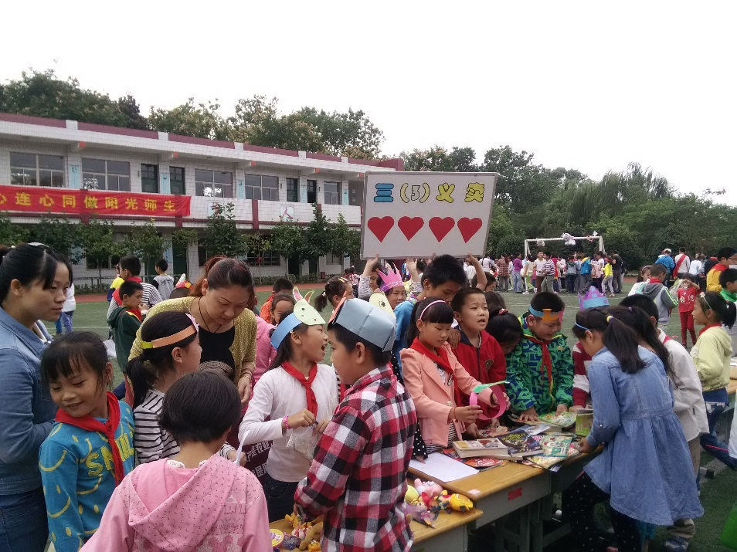
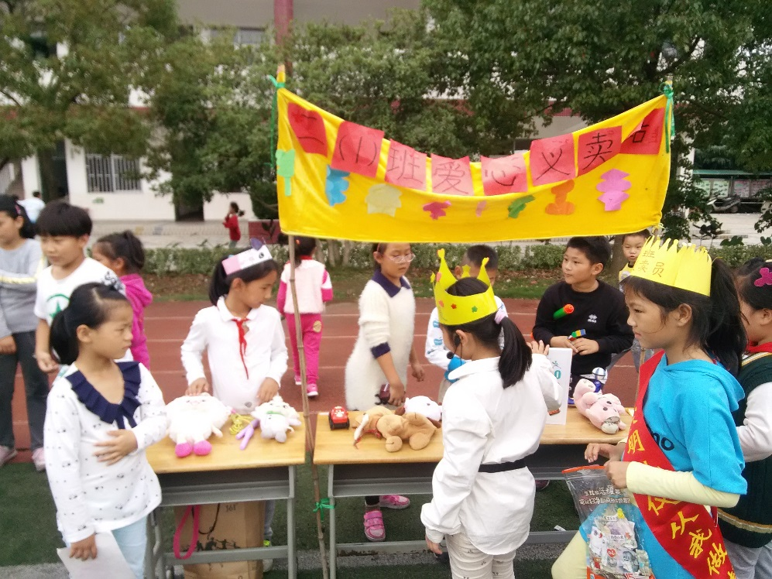
A play a game(游戏)y
B have a jumble sale(义卖)

Slide 3
What do we need for a jumble sale?
义卖我们需要什么？
A Goods 商品
B Salesmen 销售员
C Customers 顾客
D Common sentences for shopping 购物的常用表达句

Slide 4
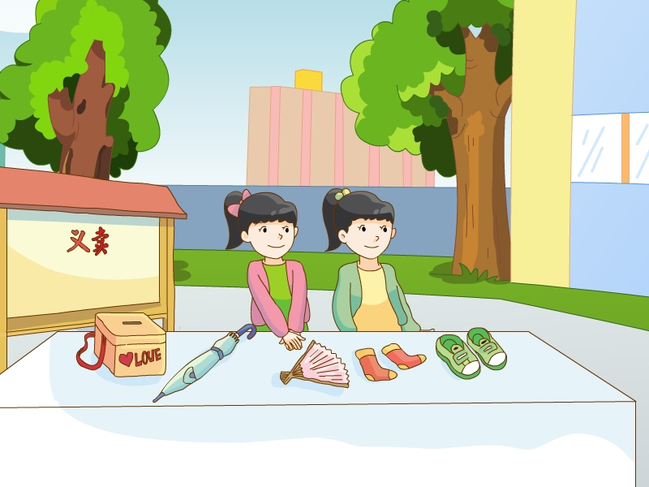
Salesgirls 女销售员

Slide 5
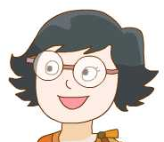
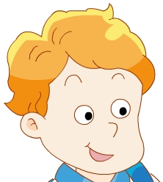
Who are the customers?
Liu Tao
Customers 顾客
Yang Ling
Mike

Slide 6
What are the goods?
Goods 商品

Slide 7
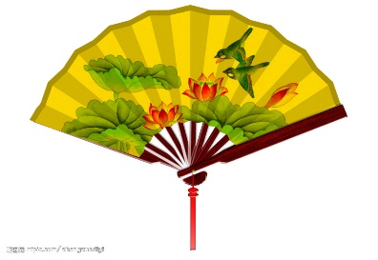
What common sentences do you know?
Can I help you？
are
five
… yuan, please.
How much…？
are
four
Here you are.
is
nineteen
is

