Slide 1
Unit7 At weekends Period 1

Slide 2
Pre-reading
Unit 7 At weekends
weekdays
December， 2019
Sunday | Monday | Tuesday | Wednesday | Thursday | Friday | Saturday
1 | 2 | 3 | 4 | 5 | 6 | 7
8 | 9 | 10 | 11 | 12 | 13 | 14
15 | 16 | 17 | 18 | 19 | 20 | 21
22 | 23 | 24 | 25 | 26 | 27 | 28
29 | 30 | 31
Sundays
+
Saturdays
=
weekends

Slide 3
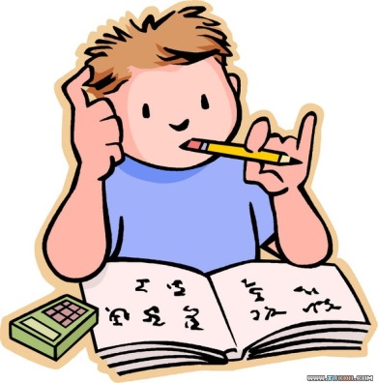
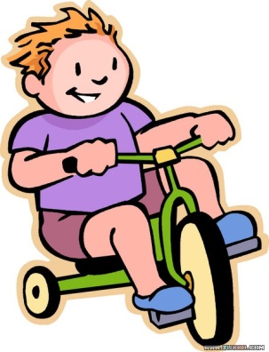
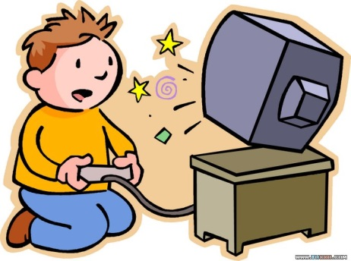
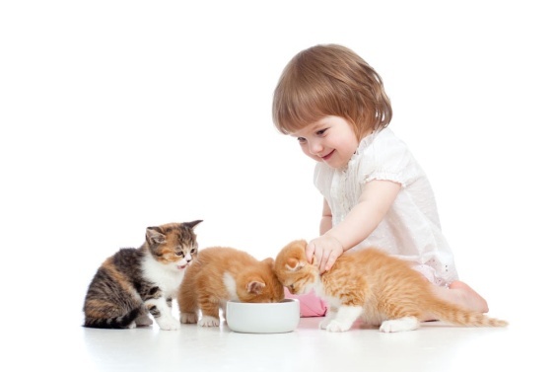
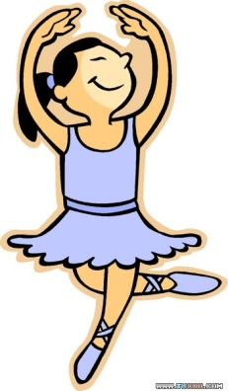
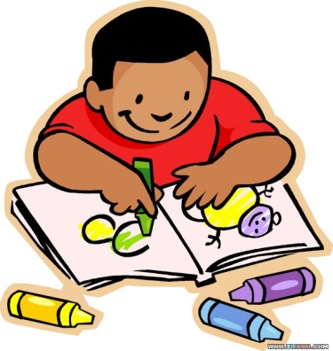
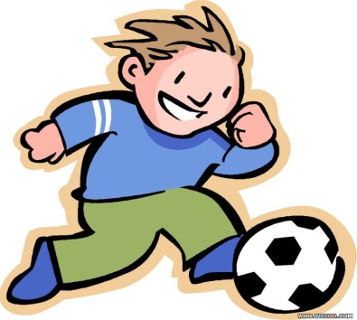
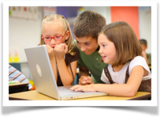
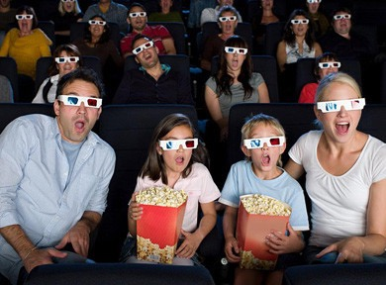
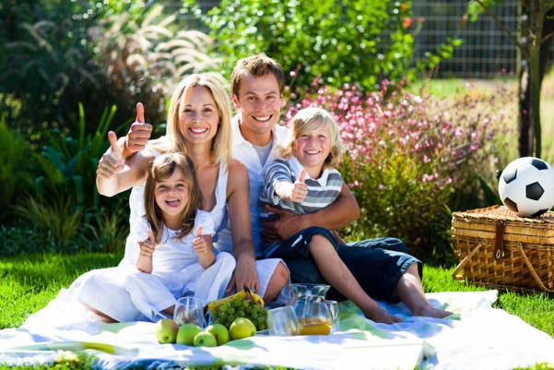
What do you do at weekends?
play with the cat
chat on the Internet
go to the cinema
fly a kite
have a picnic

Slide 4
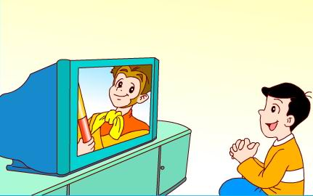
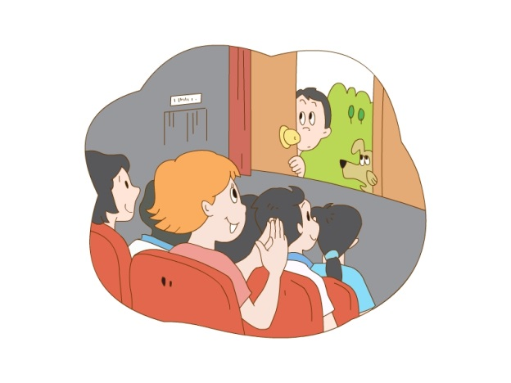
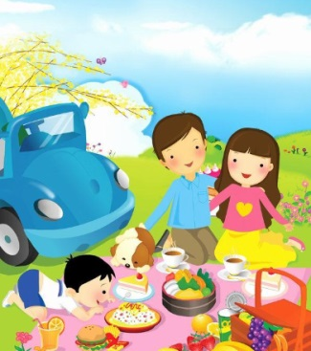
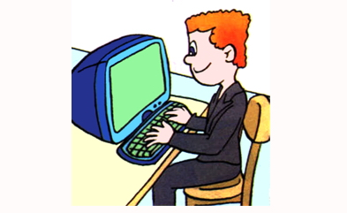
Let’s talk
always★★★★★
usually★★★★
often★★★
sometimes★★
I always…
I usually…
I often…
I sometimes…

Slide 5
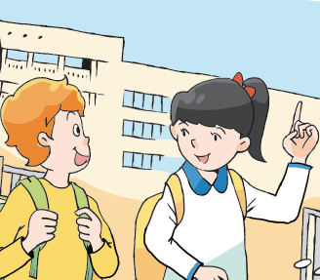
They are talking about .
Mike
Su Hai
A. their weekends
B. their friends’ weekends
C. Both A&B

Slide 7
They are talking about .
Mike
Su Hai
A. their weekends
B. their friends’ weekends
C. Both A&B

Slide 8
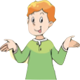
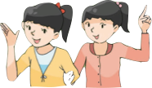
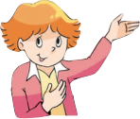
While-reading
What do they do at weekends?
Who?
Who?
at weekends
Who?

Slide 9
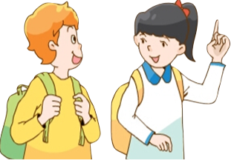
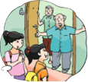
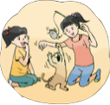
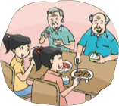
While-reading
What do you do at weekends, Su Hai ?
A. 拜访
B. 参观
I usually visit my grandparents.
Su Yang and I like playing with their
cat Kitty very much. We often have
dinner with our grandparents at
weekends.
visit
visit our grandparents
play with the cat
have dinner with our grandparents
usually
often

Slide 10
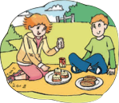
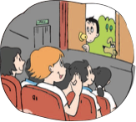
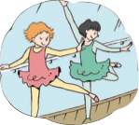
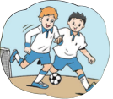
While-reading
sometimes
always
sometimes
usually
Mike: My grandparents live in the UK. I usually chat with them on the Internet
at weekends.
Su Hai: What does Helen do at weekends?
Mike: She always has dancing lessons. She sometimes goes to the cinema with
her friends.
Su Hai: What about you, Mike?
Mike: I usually play football with Liu Tao at weekends. I sometimes go to the
park with my family. We usually fly a kite and have a picnic there.

Slide 11
While-reading
usually
sometimes
often
usually
at weekends
always
sometimes

Slide 12
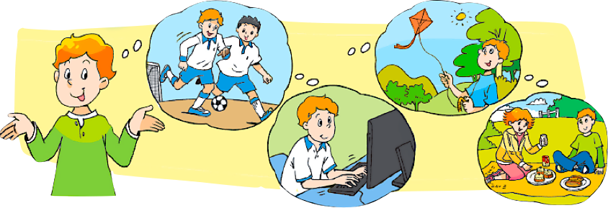
Post-reading
I usually __________ with Liu Tao at weekends. I also _______________________ on the Internet. I sometimes
________ and __________ with my family in the park.
play football
chat with my grandparents
fly a kite
have a picnic

Slide 13
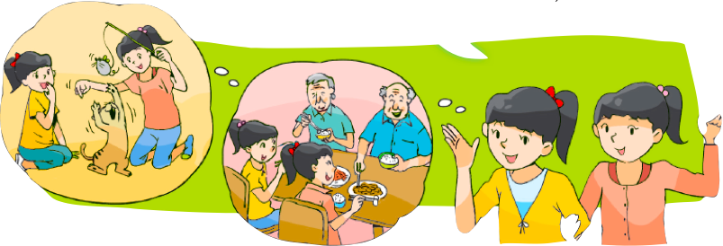
Post-reading
Su Yang and I usually _______________ at weekends.
We _______________ Kitty. We _______________ with
our grandparents.
visit our grandparents
play with their cat
often have dinner

Slide 14
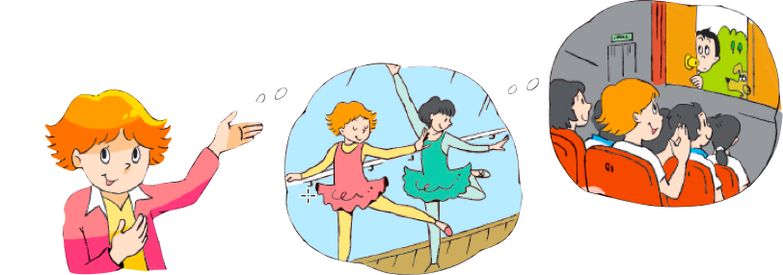
Post-reading
I always _________________ at weekends. I
sometimes _______________ with my friends.
have dancing lessons
go to the cinema

Slide 15
Read after the tape

Slide 16
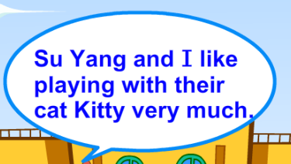
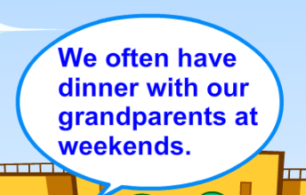

Slide 19
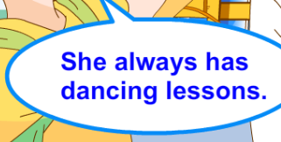

Slide 23
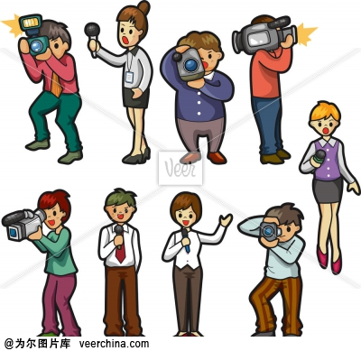
Make a report
Now you are a reporter.
Please tell us their weekends.
Think and write

Slide 24
Homework
1. Read the story
2. Finish your survey and be ready for making a report

