Slide 1
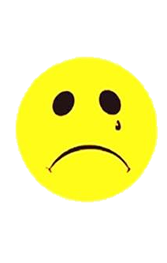
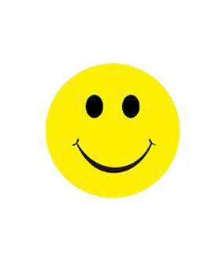
Let’s judge!
Goldilocks is in the park..
forest
There is a house in the forest..
There is some milk on the table..
soup
There are four beds in the room..
three

Slide 2
Let’s judge!
There are two bears in front of her..
three
Goldilocks is afraid of bears..

Slide 3
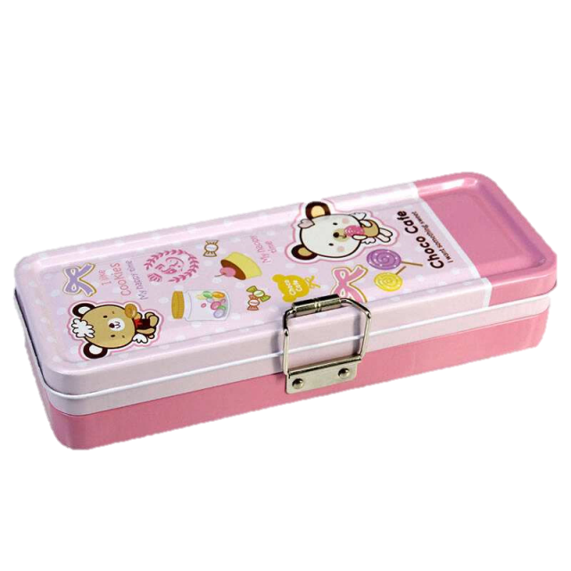
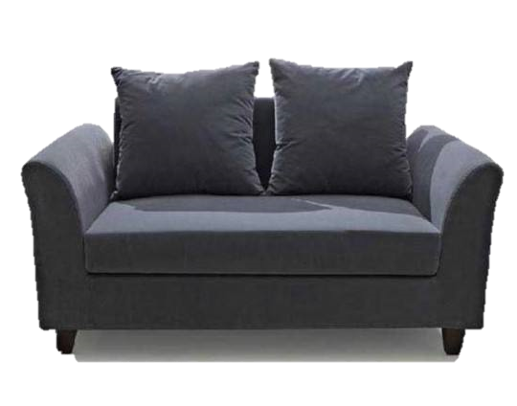
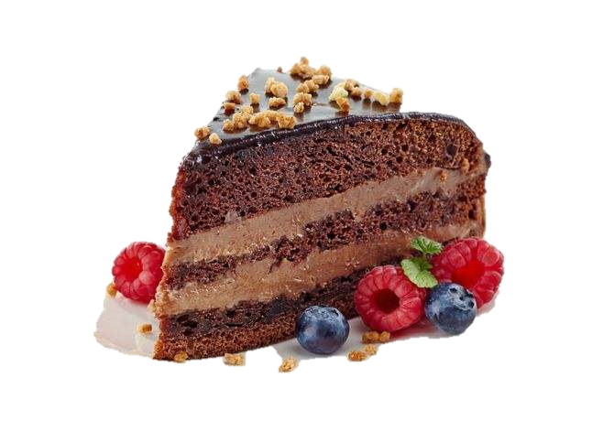
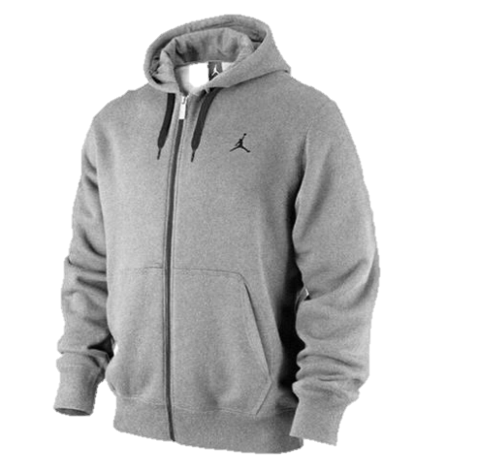
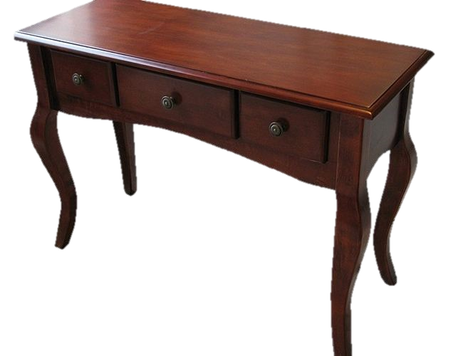
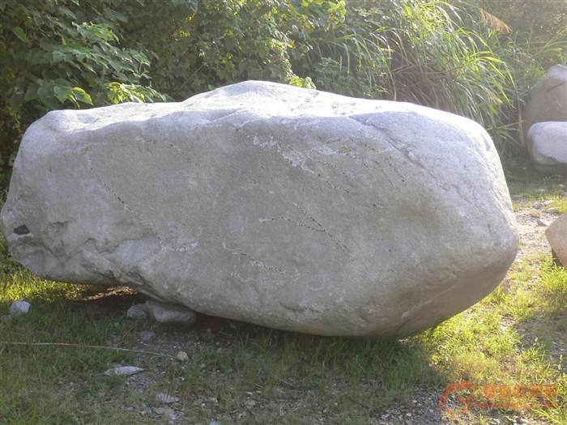
Look and say
The is hard.
The is soft.

Slide 4
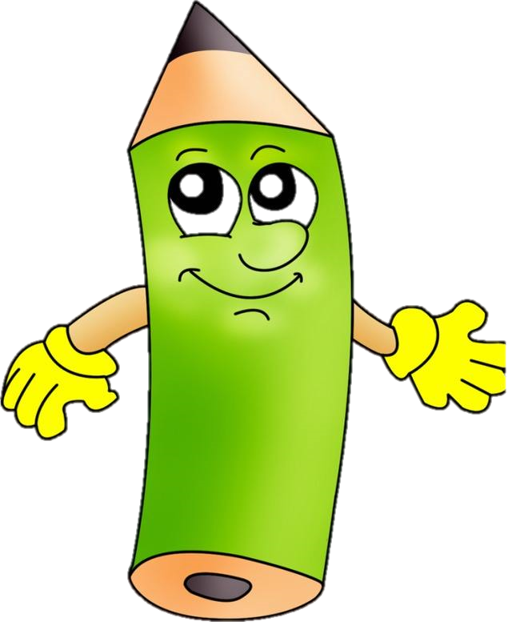


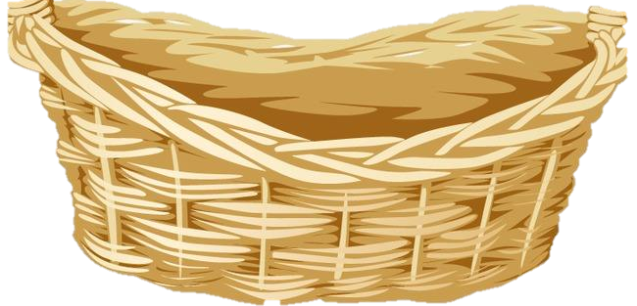
Antonym(反义词)
cold
hot
small
big
short
tall
young
hard
soft
old

Slide 5

beside
between
in front of

Slide 6
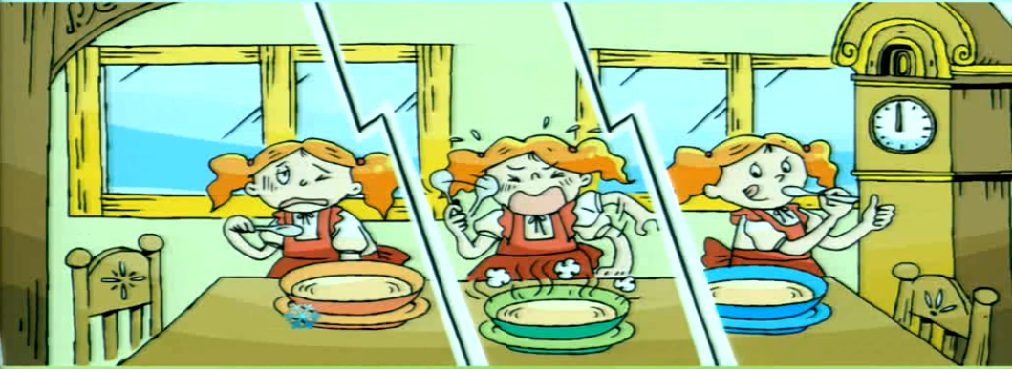
This soup is too…

Slide 7
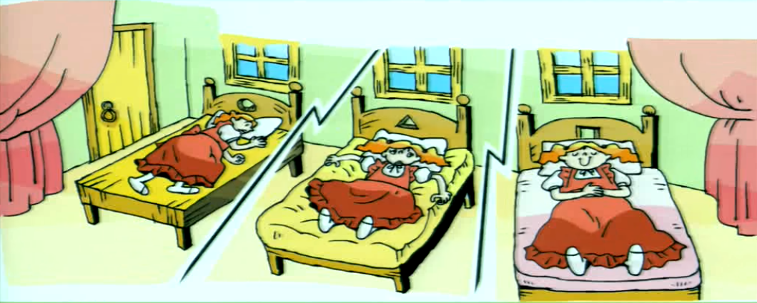
This bed is too…

Slide 8
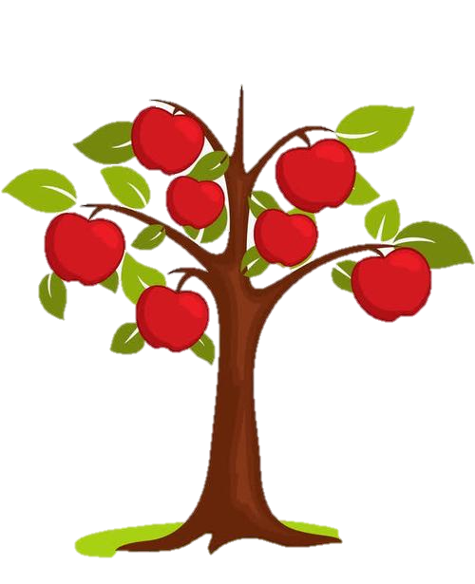
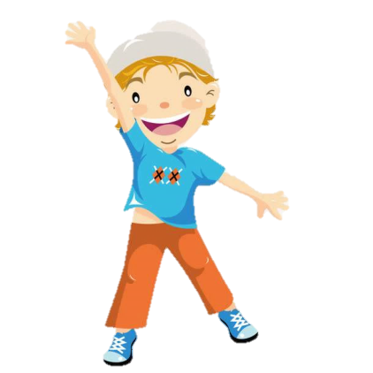
too
The tree is high.
He reach the apple.
can’t

Slide 9
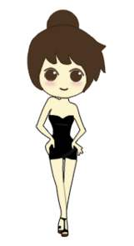
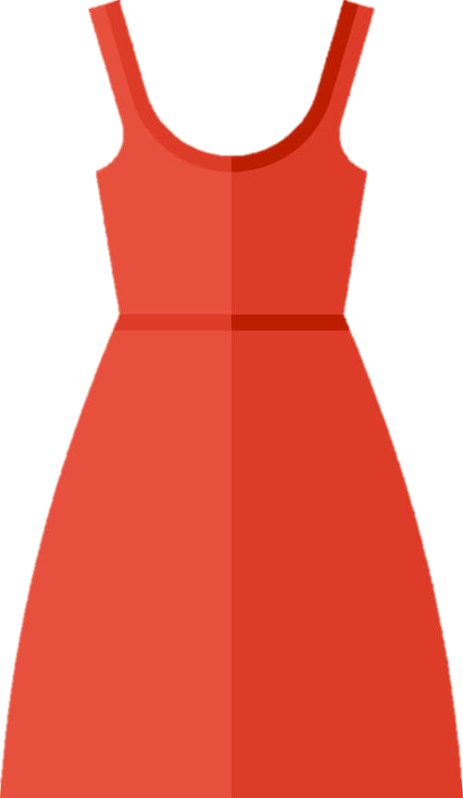
The dress is big.
She wear it.
too
can’t

Slide 10
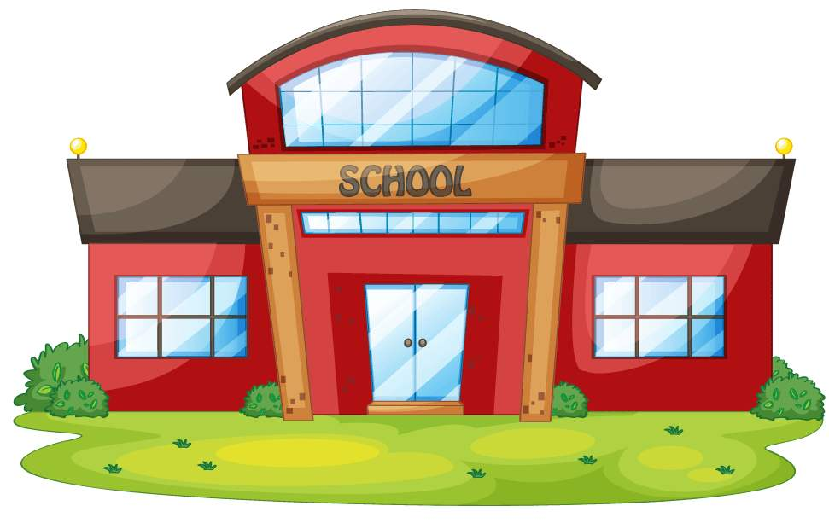
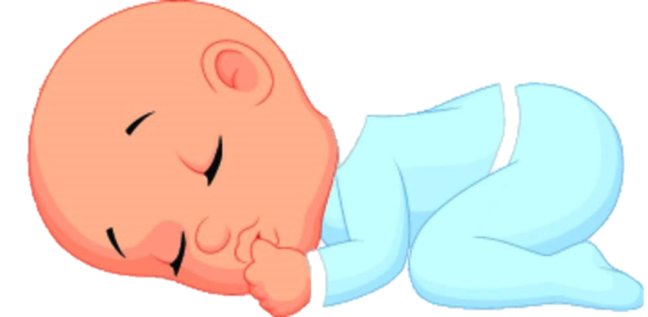
too
The baby is young.
He go to school.
can’t

Slide 11
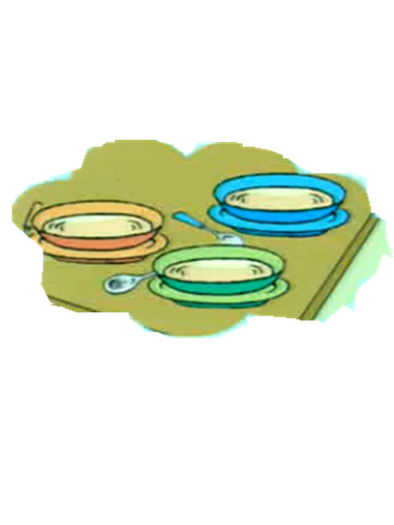
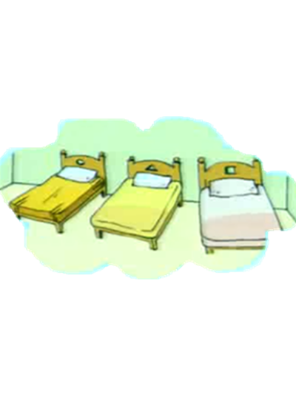
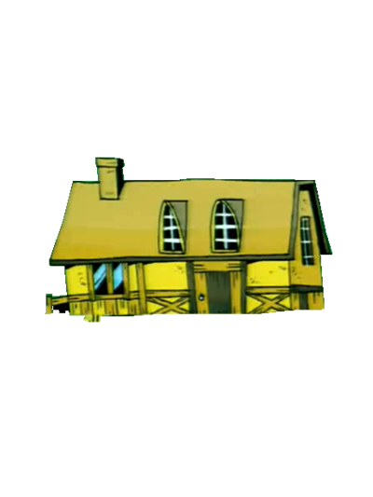
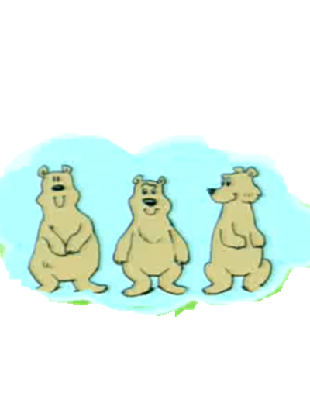
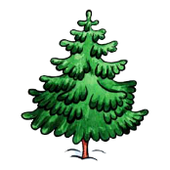
Think and say
There’s—in the forest.
There’s–on the table.
There are—in the room.
There are—in front of me.

Slide 12
There is a house in the forest.
There is some soup on the table.
There are three beds in the room.
There are three bears in front of her.

Slide 13
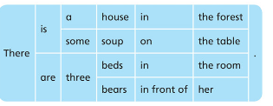
There be句型中， is 用来修饰可数名词单数和不可数名词。
are用来修饰可数名词复数。

Slide 14
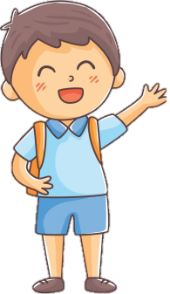
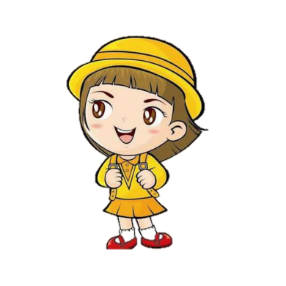
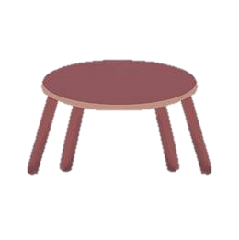

is
are
is
There a flower on the table.

Slide 15
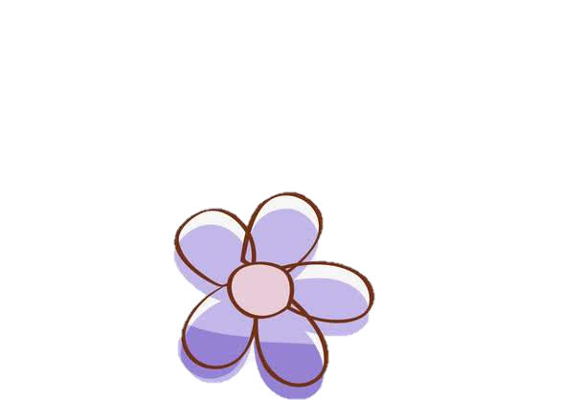


is
are
There some flowers on the table.
are

Slide 16
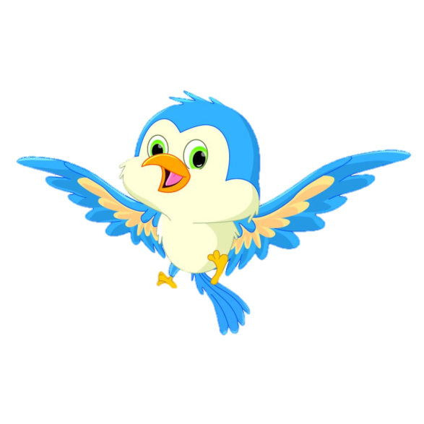
is
are
is
There a bird under the table.

Slide 17

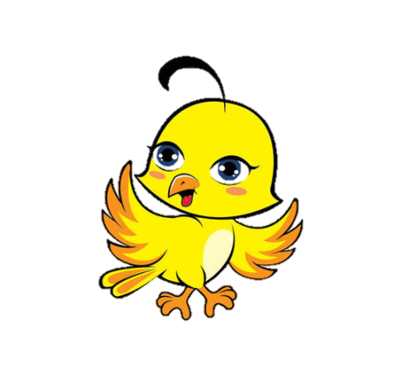
is
are
There two birds under the table.
are

Slide 18
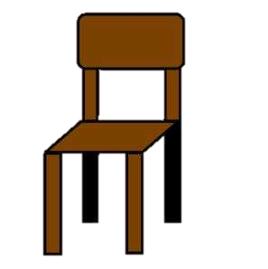
is
are
is
There a chair beside the table.

Slide 19
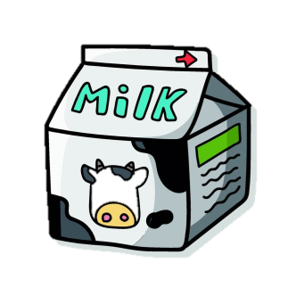
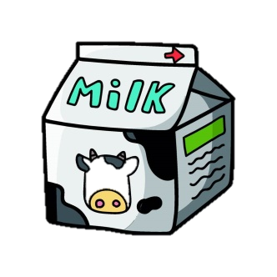
is
are
There some milk on the table.
is

Slide 20
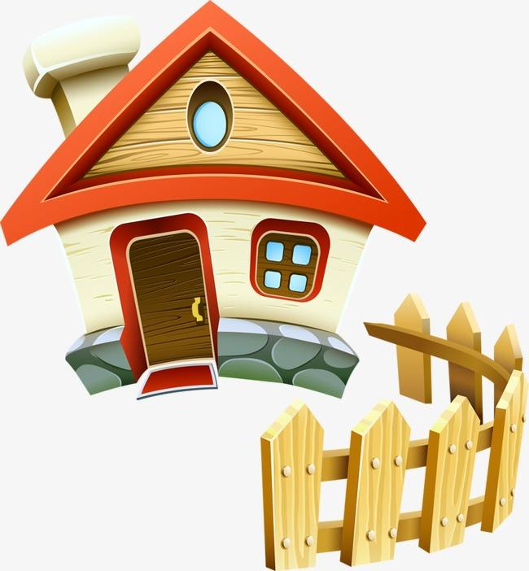

Slide 21
