Slide 1
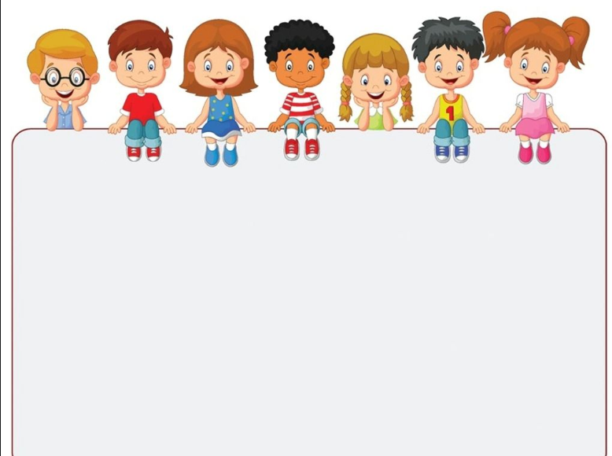
My school life
我的校园生活
Li Jingjing

Slide 2
Teaching aims 教学目标:
1.I can say and write the names of school subjects.
2.I can say the days of a week.
3.I can use “what” to ask about subjects.
4.I can talk about my day.
5.I can use “when” to ask about daily activities.
Prize 奖励
1.每答对一个问题，往笔筒里放进一支笔，每组投入笔最多的同学获胜。
2.笔筒内铅笔最多的小组获得小组团体冠军。

Slide 3
Enjoy a song

Slide 4
What day is it today？

Slide 5
My school life
我的校园生活

Slide 6
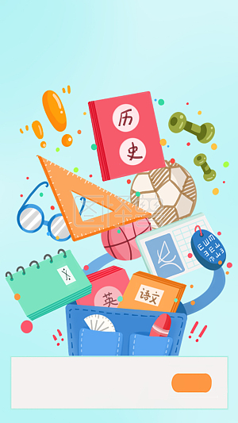
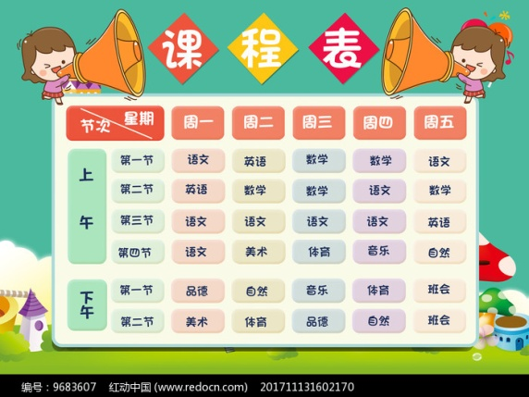
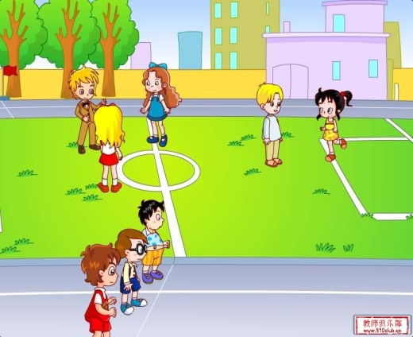
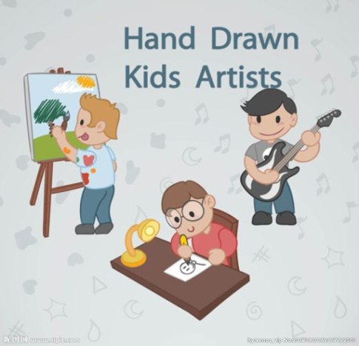
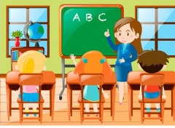
当你谈论School life时，你会谈些什么话题？

Slide 7
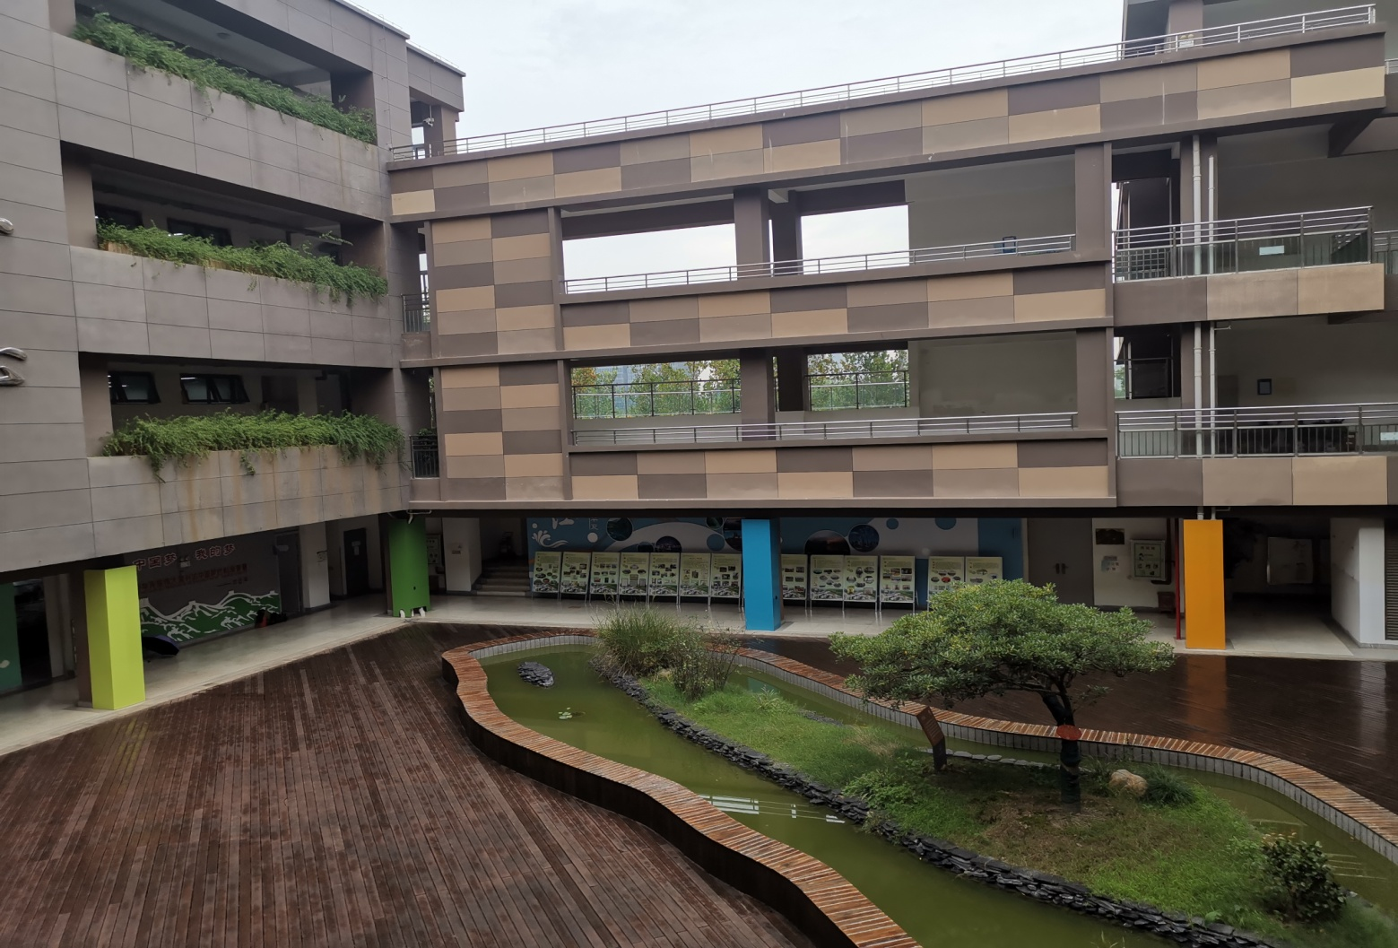
Pictures of school
What can you see?

Slide 8
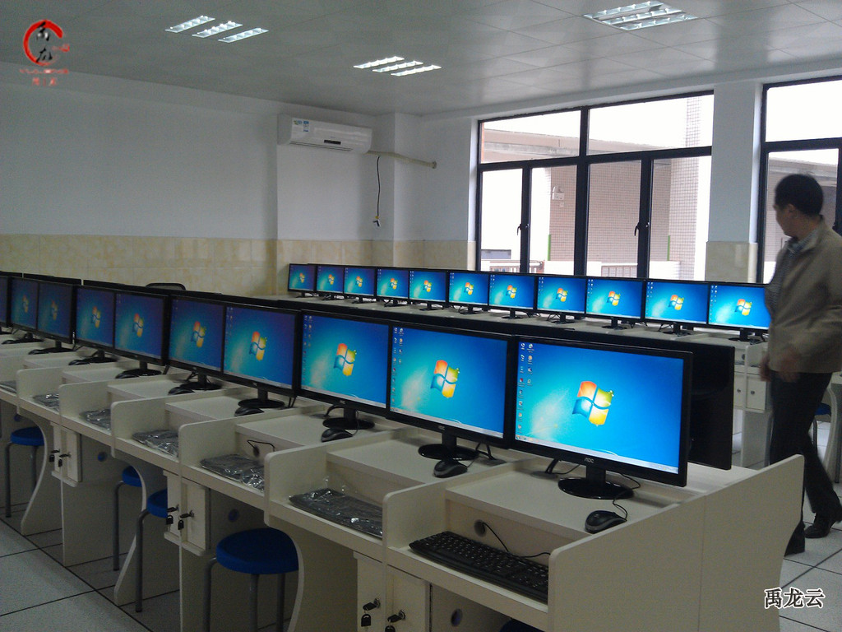
computer room

Slide 9
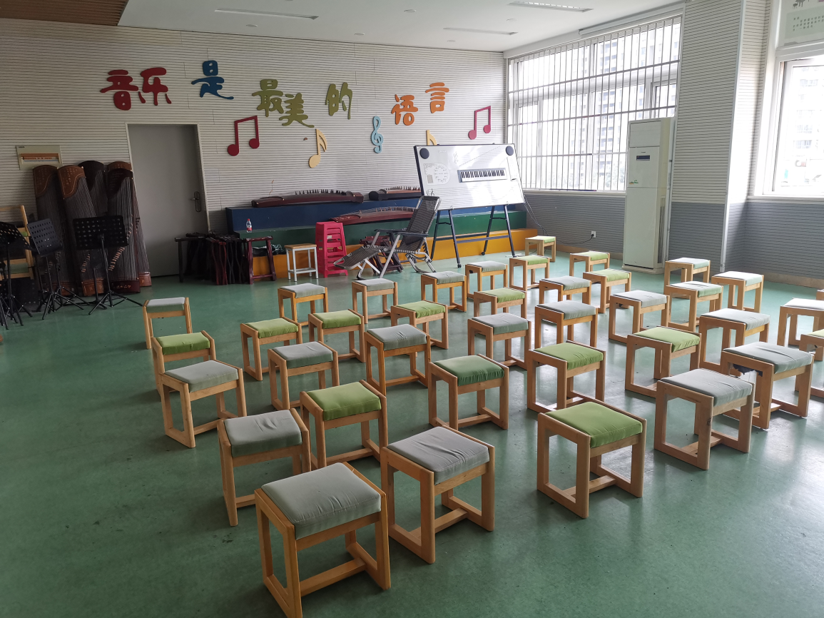
What can you do ?
music room

Slide 10
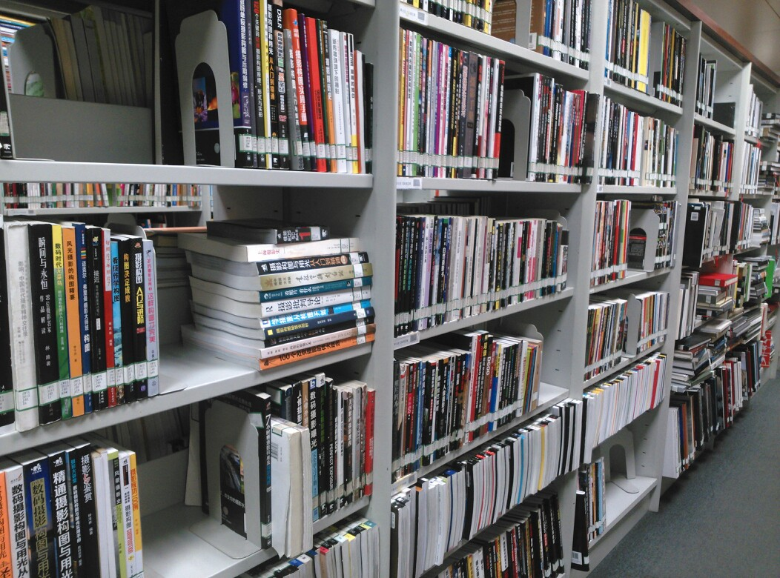
library

Slide 11
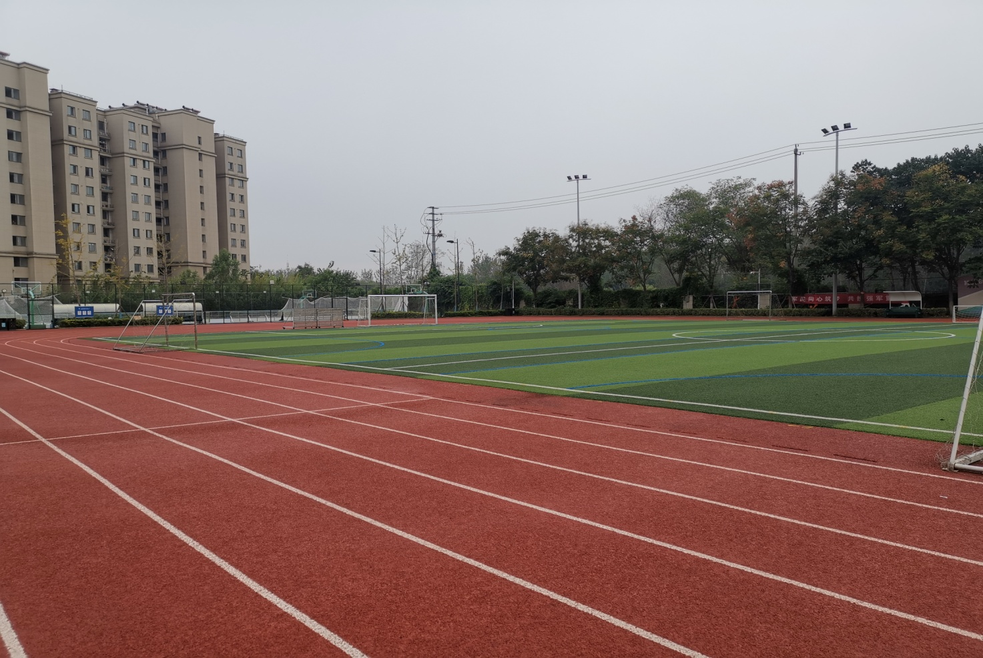

Slide 12
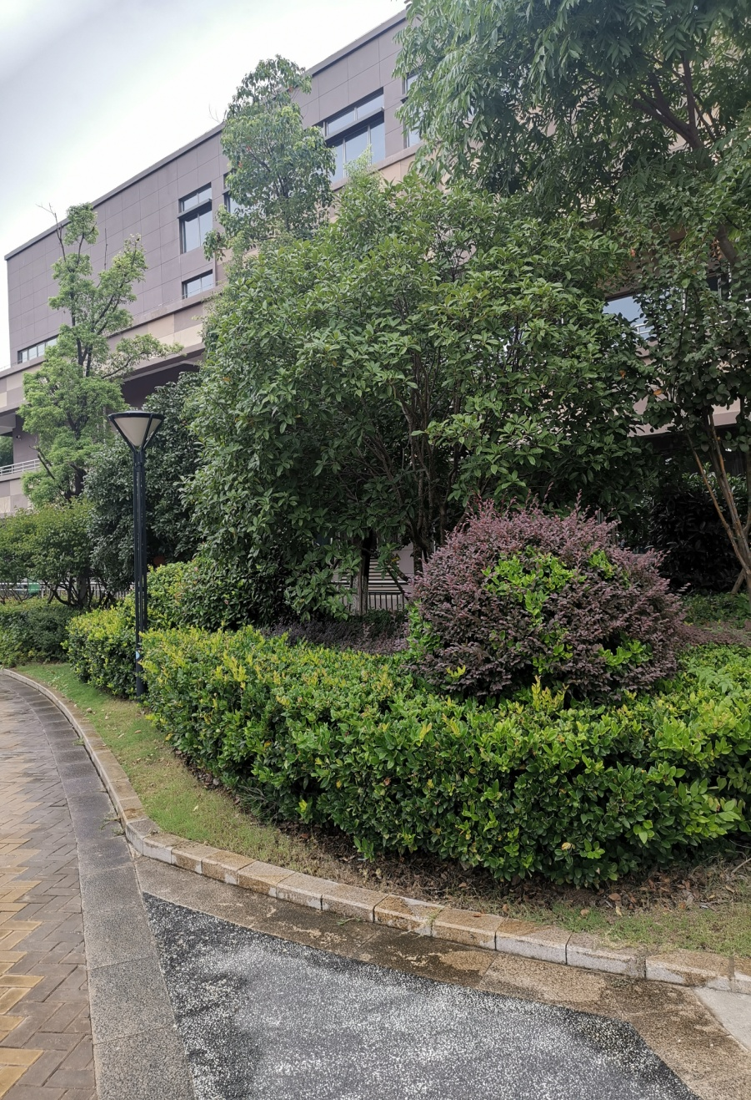
Introduce your school
向大家介绍你的校园
This is our school. It is ...
This is our …
You can see... You can…
You can see …at my school.
I love my school.

Slide 13
Subjects
What subjects do you know ?
I know ...
What subjects do you like?
I like…It’s…

Slide 14
1.Tick and write
勾出你喜欢的课程，并补全句子。
2.Talk in groups
小组讨论，说说你喜欢的课程。
My school subjects
Chinese
Maths
English
PE
Study every subject well.
认真学好每一门功课。
Science
Art
Music
I like , and …
It’s/ They’re _________.

Slide 15
What lessons do you have on…?
I have…

Slide 16
Class 1 timetable
Tuesday
Monday |  | Wednesday | Thursday | Friday
Morning
Afternoon
Maths
Chinese
Chinese
Maths
Science
English
English
Calligraphy
Music
Art
PE
Music

Slide 17
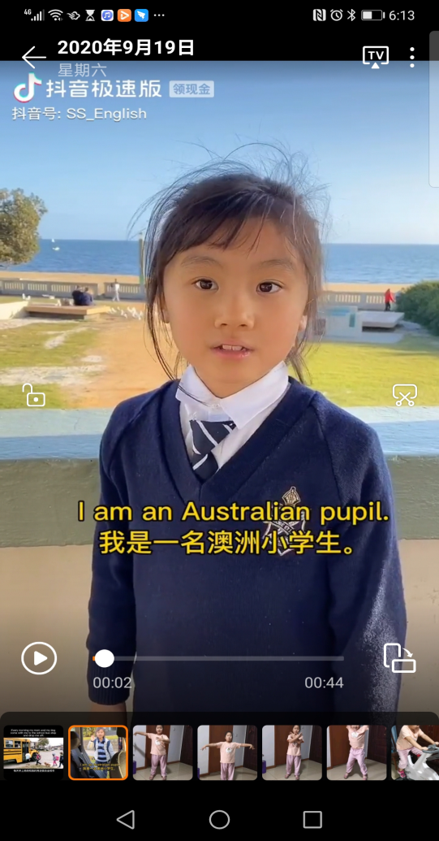
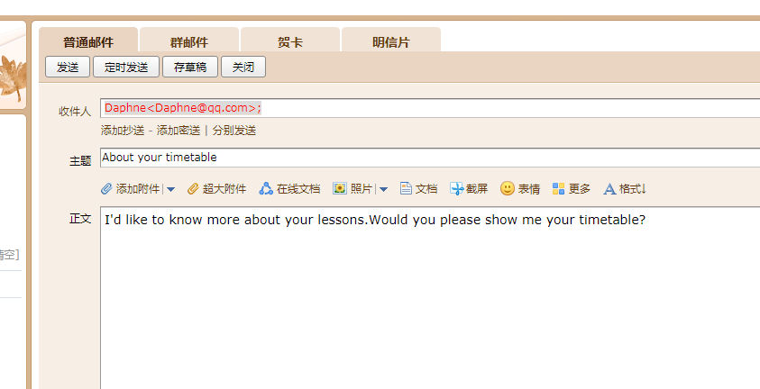
Write and say
1.Finish Exercise 2.
根据课表提示，完成练习2。
2.Talk with your partners.
小组内分享你的课表。

Slide 18
Our timetable
Tuesday
Monday |  | Wednesday | Thursday | Friday
Morning
 |  | Maths | Maths | Chinese
 |  | English | Chinese | Maths
 |  | Chinese | Computer | English
IC 综合 |  | ME | IC | Calligraphy
Afternoon
 |  |  | PE | CM
 |  |  | English | Science
Chinese
Maths
Maths
Chinese
Art
Science
English
Music
Football
Art
PE
ME(德法）
Music

Slide 19
Let’s share
Dear Cici,
On my timetable,I usually have six ______ every day. On Monday morning, I have Chinese, _______, ______ and IC.In the ______, I have _____ and PE. On Wednesday afternoon ,I have _____ and Music.
I like _____ best. It’s my favourite(最爱的) _______.It’s very _______.

Slide 20
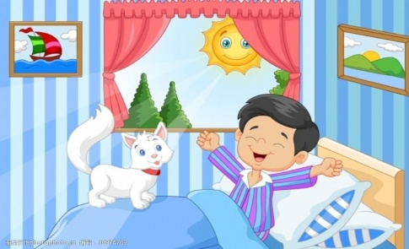
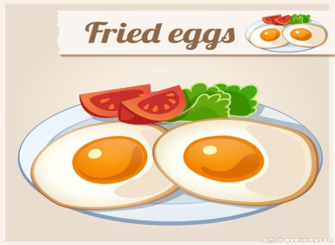
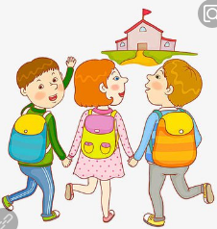
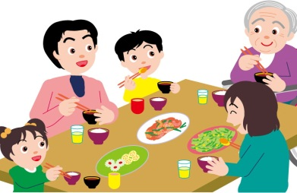
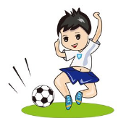
Know more about your day
When do you … ?
I…at…

Slide 21
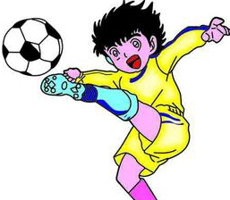
My day
Fill the table and talk about your day.
1.完成练习3
2.和同桌说说你一天的活动。
Time | Activity
Time | Activity
 | Get up
12:00
 | Do homework
7:40 | Go to school
 | Go to bed
I get up at …in the morning.
I usually/often …at…
After school, I …at…
I…at…

Slide 22
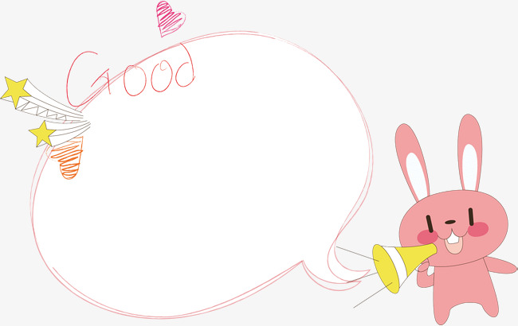

Slide 23
Cici’s school life

Slide 25
Write to Cici
Write about your school life.

Slide 26
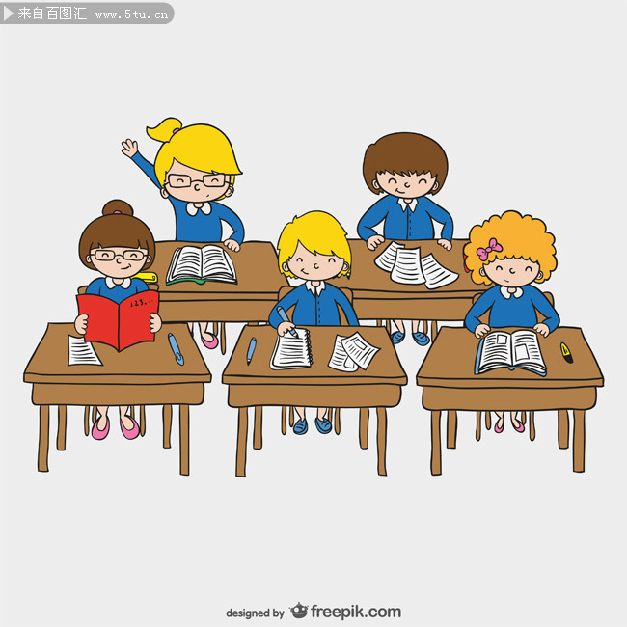
Study really hard.
Love our school.
Enjoy our school life.

Slide 27
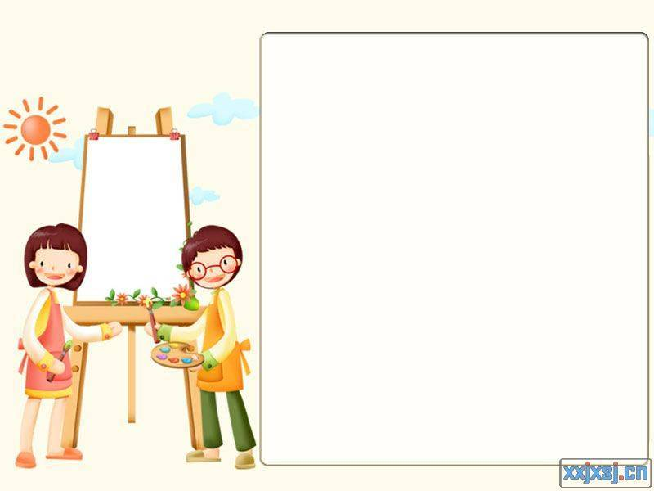
Homework：
Read the words and sentences we learned fluently.
流利地朗读1至4单元的故事和卡通板块。
2. Go on writing your letter to Cici and share with your classmates.
完善写给Cici的信，和同学们分享。

Slide 28
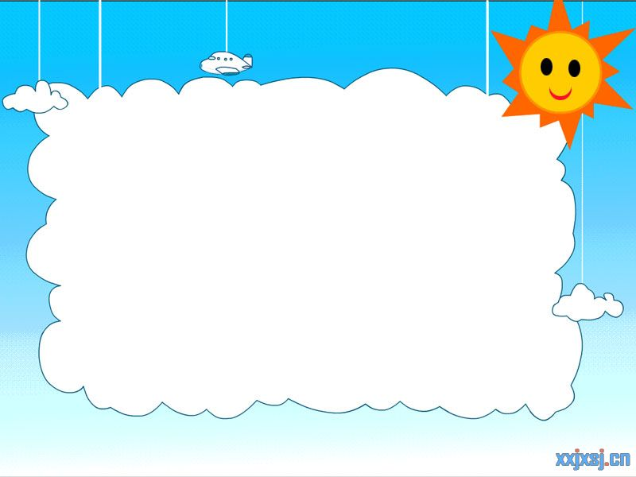
Thank you!

