Slide 1
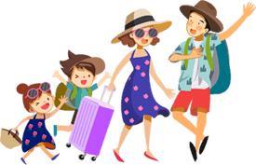
Unit 3
Holiday fun
Period 2 Grammar time~Culture time

Slide 2
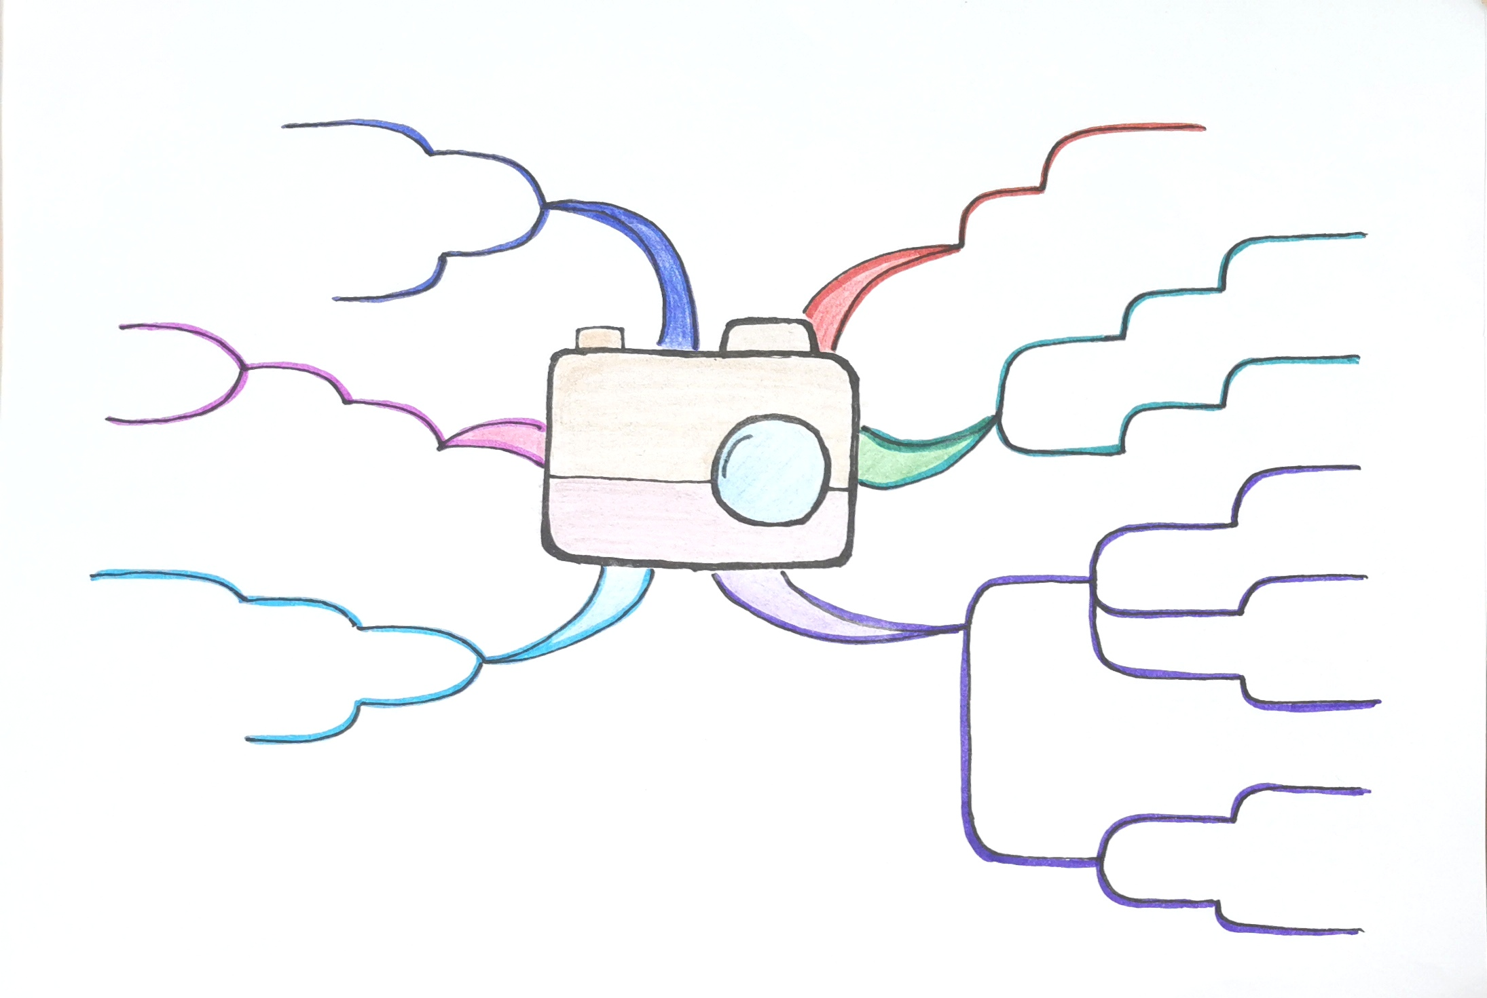
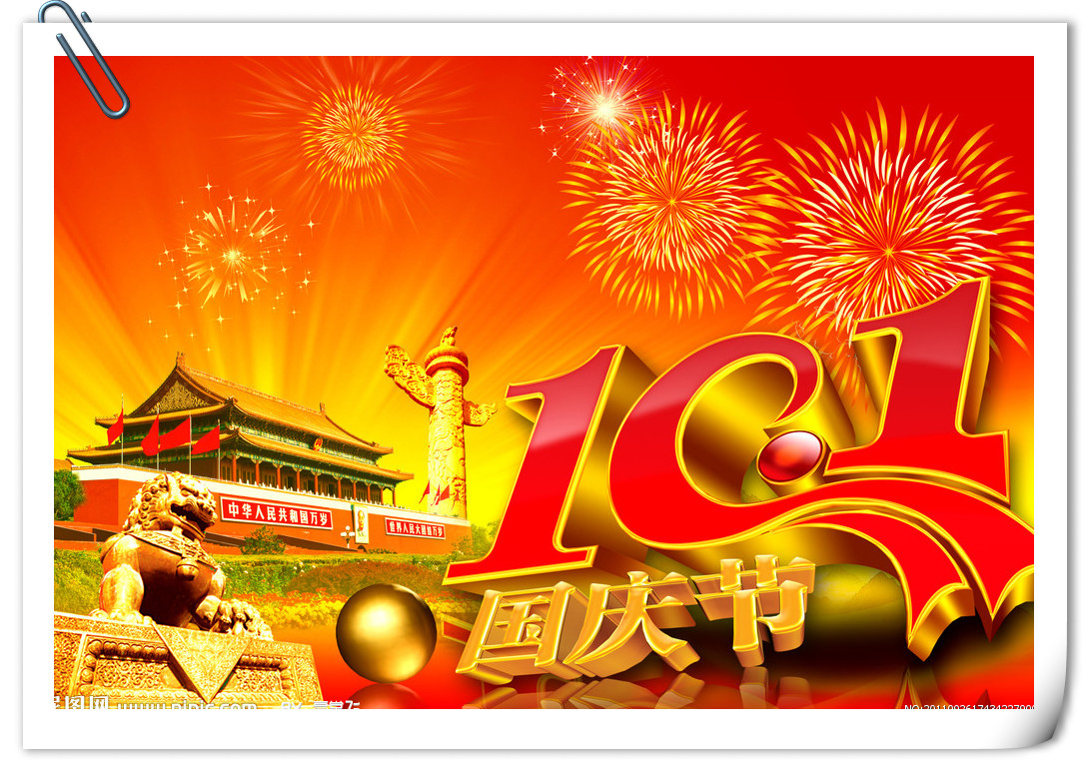
Let’s review
Did ...?
was
What was...?
Unit3
Why did...?
Where...go?
Holiday
fun
Liu Tao’s
What...do?
How was... ?
Mike’s

Slide 3
Did ...?
What was the holiday?
What was...?
How was the holiday?
Why did...?
Where...go?
Where did Liu Tao / Mike go?
What did Liu Tao / Mike do?
What...do?
How was... ?
Why did Mike call Liu Tao?
Did Liu Tao / Mike eat the fish?

Slide 4
找一找句子结构的规则
be
+ noun phrase(名词词组)
What was the holiday ?
simple past tense 一般过去时
do, does, can, could, may...
be
was
were
How was the holiday ?
simple present tense 一般现在时
Where did Liu Tao/Mike go ?
be
am
is
are
do
original form
(动词原形)
did ...
What did Liu Tao/Mike do ?
Why did Mike call Liu Tao ?
Did Liu Tao/Mike eat the fish ?

Slide 5
Was ... ?
Were ... ?
Am ... ?
Is ... ?
Are ... ?
Did ... ?
Do ... ?
Does ... ?
Can ... ?
Could ... ?
...
the wh-questions
What was the holiday ?
（特殊疑问句）
interrogative adverbs
what
where
why
how
How was the holiday ?
(疑问副词)
when
Where did Liu Tao/ Mike go?
who
whose
What did Liu Tao/ Mike do?
...
rising intonation 升调
Why did Mike call Liu Tao?
Did Liu Tao/ Mike eat the fish ?
the yes-no questions （一般疑问句）

Slide 6
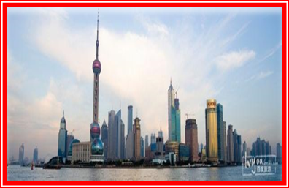
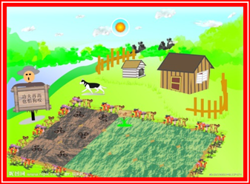
×
didn’t eat
didn’t
was
Did ...?
was
What was...?
√
ate
went
ate
went
caught
caught
called
called
Unit3
went
wanted
went
wanted
Why did...?
Where...go?
Holiday
fun
visited
visited
interesting
fun
What...do?
went
went
Liu Tao’s
How was... ?
visited
visited
Mike’s
fun
picked
picked
went
went

Slide 7
Fill in the blanks (根据课文内容及提示帮助Mike完成日记)
Tuesday 9th October
were
Our holidays _____ both fun.
I ______ (write) a rhyme about my holiday.
Hey! Please pick an orange for me.
I want an orange from the tree.
Hey! Please catch a fish for me.
I want a fish from the sea.
What a wonderful holiday!
wrote
talked
Today, I ______(talk) with my
classmate LiuTao about this
National Day _______.
I knew why Liu Tao ______
at home. He _____ to Shanghai
and ______ his aunt. He ____
(tell) me that the Bund was very beautiful in the evening. And the Shanghai Museum was worth to visit. He _____(see) many _________ things there.
holiday
wasn’t
went
visited
told
saw
interesting

Slide 8
intonation 语调
falling intonation 降调

Slide 9
Let’s make it fun.

Slide 10
There are a lot of holidays in a school year in China.
在一学年里
There are usually two main school holidays in China.
两个主要的学校假期
the summer holiday
the winter holiday
There are usually two terms in a school year in China.
一学年里两个学期
the autumn term
the spring term

Slide 11
There are three main school holidays in the UK.
How many main school holidays are there in a school year in the UK?
A. The spring term B. the autumn term C. the summer term
D. the winter term E.The Halloween holiday F. the Easter holiday
G. the Christmas holiday H. the summer holiday I. the winter holiday
How many terms are there in a school year in the UK?
There are usually three terms in a school year in the UK.
time
3 terms
3 holidays
Sept.~Dec. 3months
B
the autumn term
Dec.~Jan. 3weeks
the Christmas holiday
G
Jan.~Mar. 2months
the spring term
A
Mar.~Apr. 3weeks
the Easter holiday
F
Apr.~Jul. 3months
the summer term
C
Jul.~Sept. 2months
the summer holiday
H

Slide 12
Let’s talk about your travel experiences.
Tips: buy some souvenirs(纪念品), taste(品尝) delicious food, take some photos, visit...
I want to talk about
this/last_________ holiday.
How
How was your holiday?
It was ___________ .
Where
Where did you go ?
I went to _________ .
What
What did you do there?
I ________________ .
Did
Did you __________?
Yes,I did. /No, I didn’t.

Slide 13
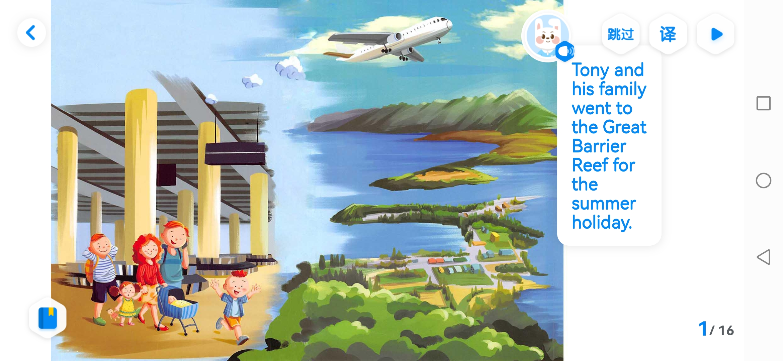
Fun in the sea
Tony’s summer holiday
从以下几个方面的问答学习了解这个故事，并试着画一画思维导图。
How
How
Where
Where
What
Did
What
Did

Slide 14
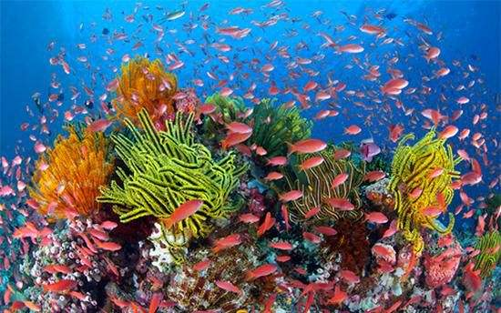
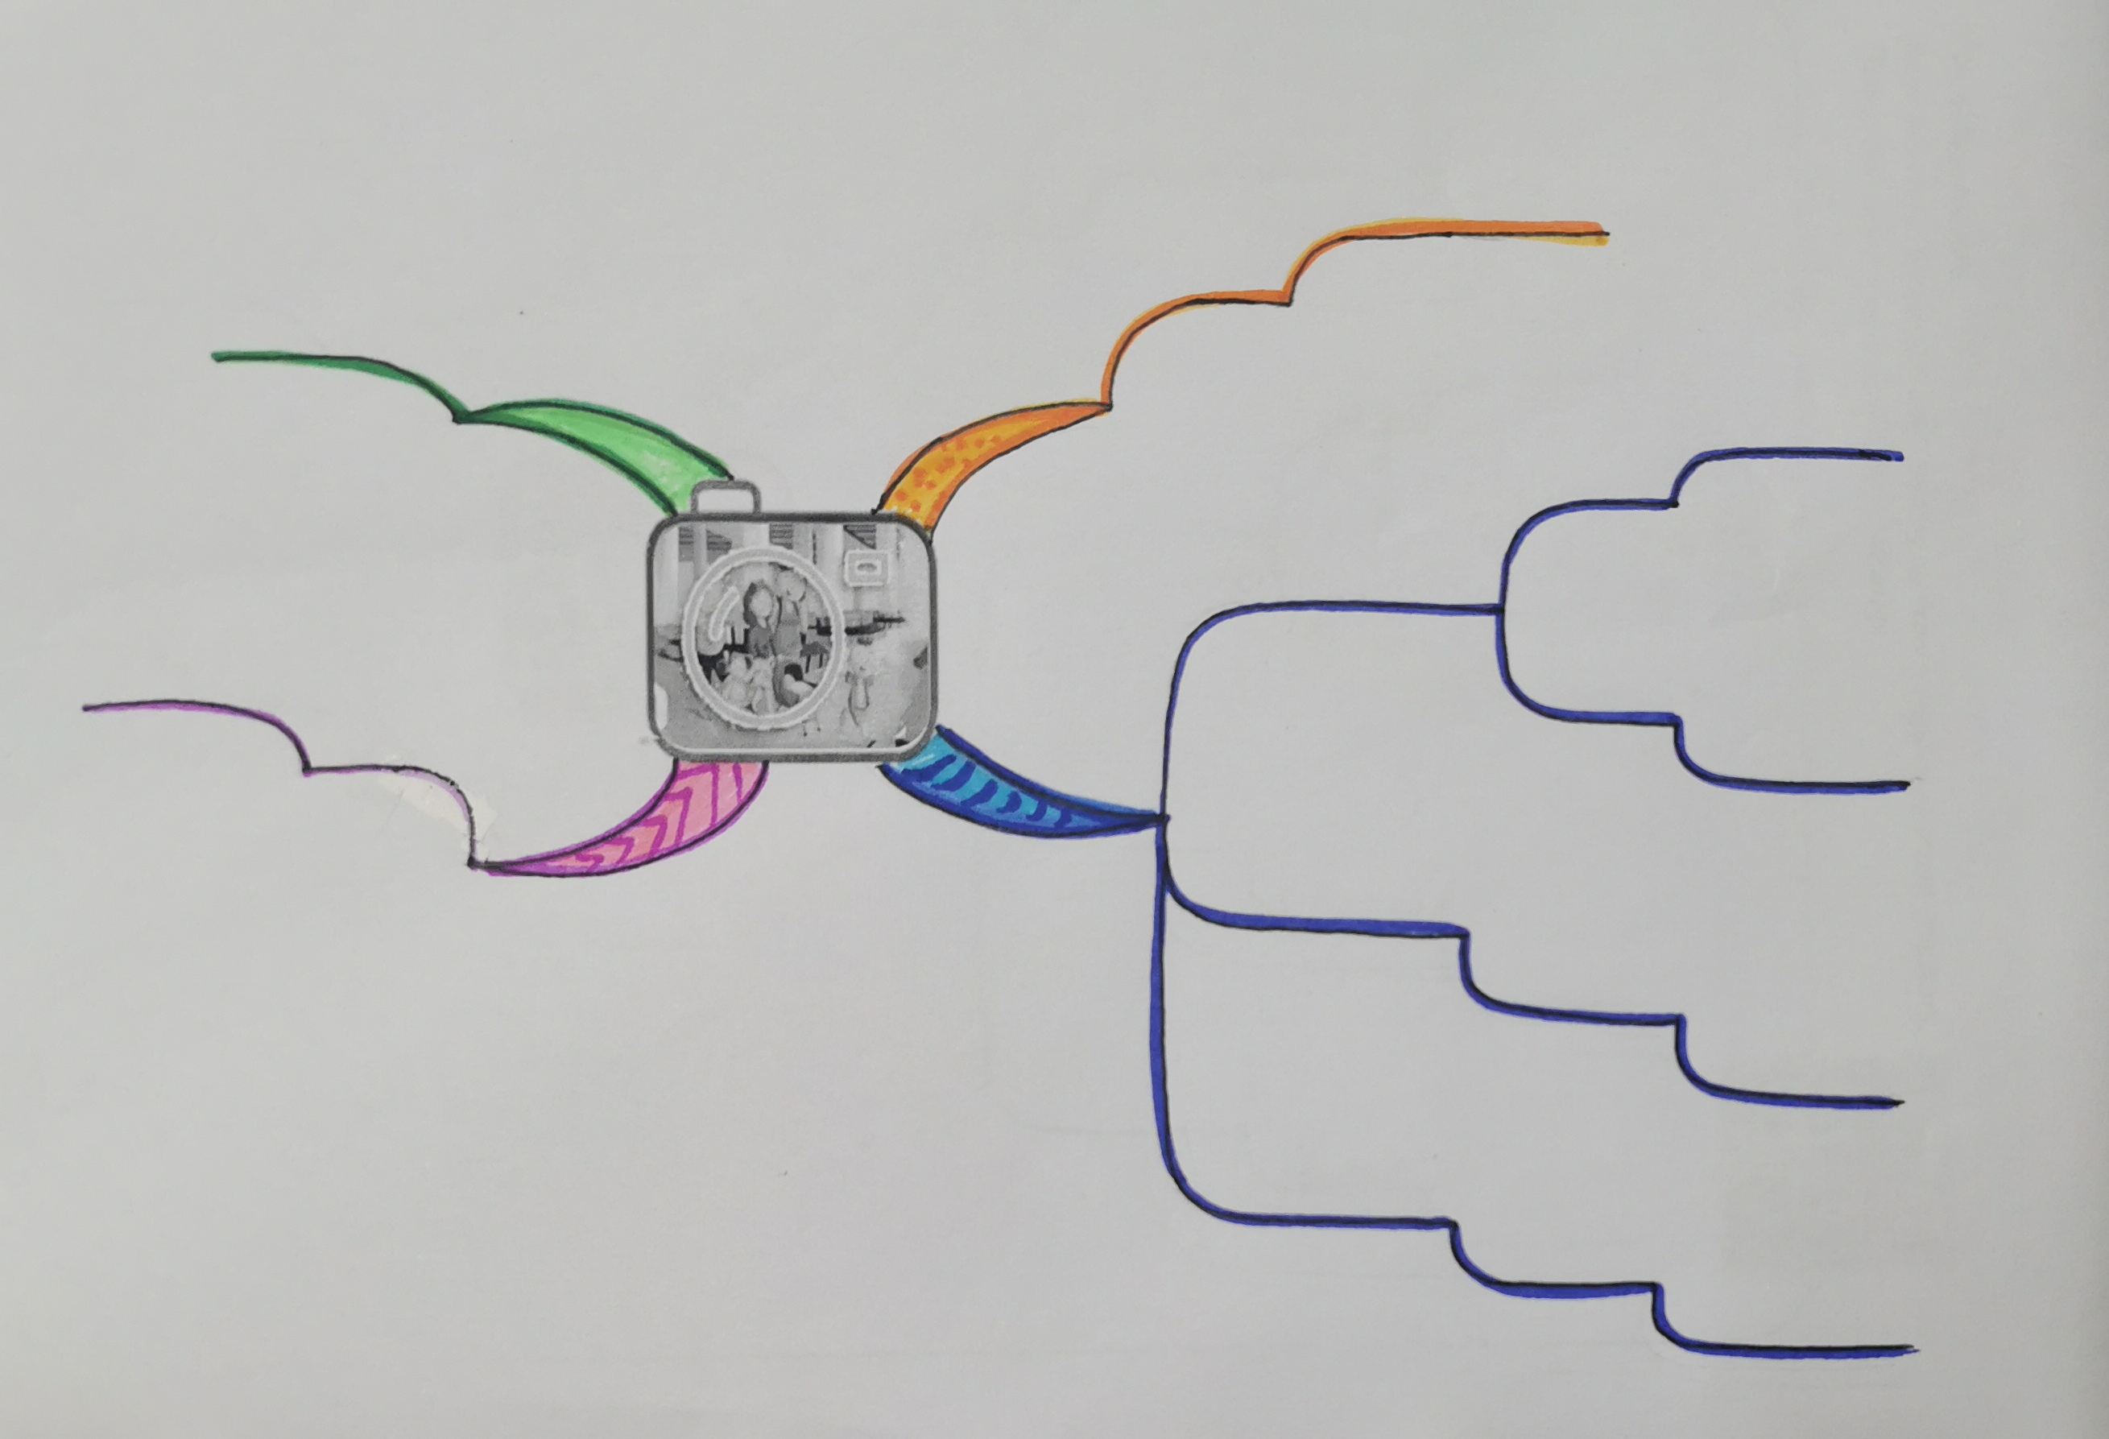
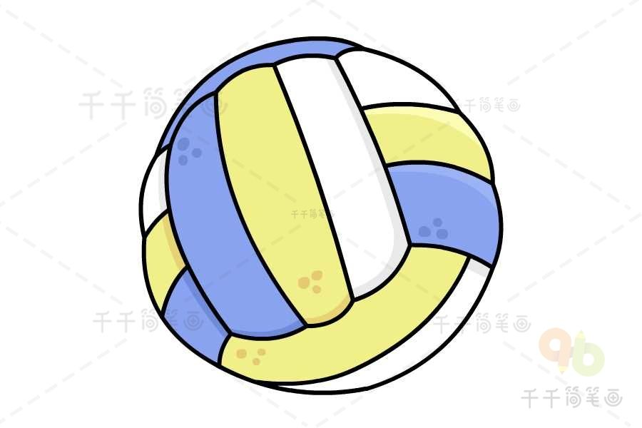
Who? Why？...
the Great
Barrier Reef
went
fun
was
How ... ?
Where...?
played
Fun in
the sea
went
see
What...?
diving
Did ...?
enjoyed
sunshine
played

Slide 15
Homework：
1 Recite story time by the mind map.
2 Read the story Fun in the sea again.
Try to ask more questions and answer them.
3 Preview cartoon time.

Slide 17
How
How was your holiday?
Where
Where did you go ?
What
What did you do there?
Did
Did you __________?

Slide 18
Let’s talk about your travel experiences.
How
How was your holiday?
It was ___________ .
Where
Where did you go ?
I went to _________ .
What
What did you do there?
I ________________ .
Did
Did you __________?
Yes,I did. /No, I didn’t.

