Slide 1
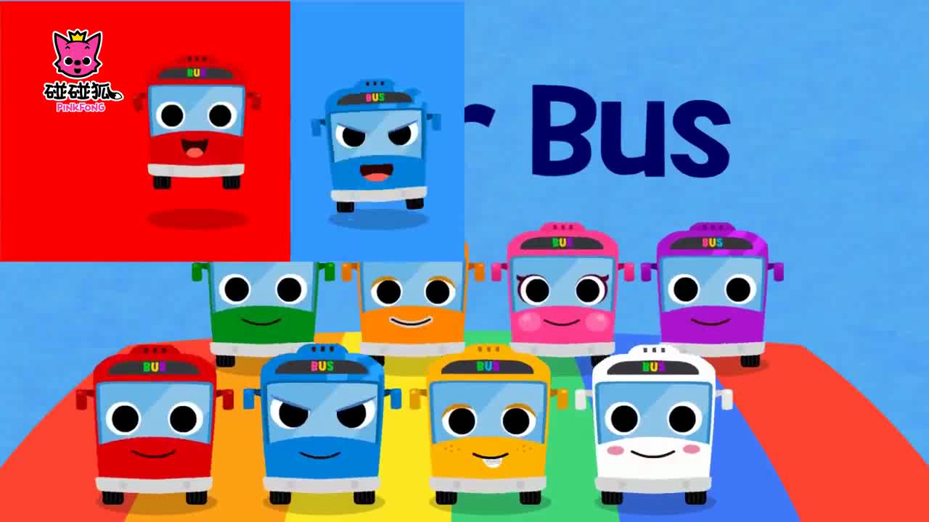
Enjoy the song

Slide 2
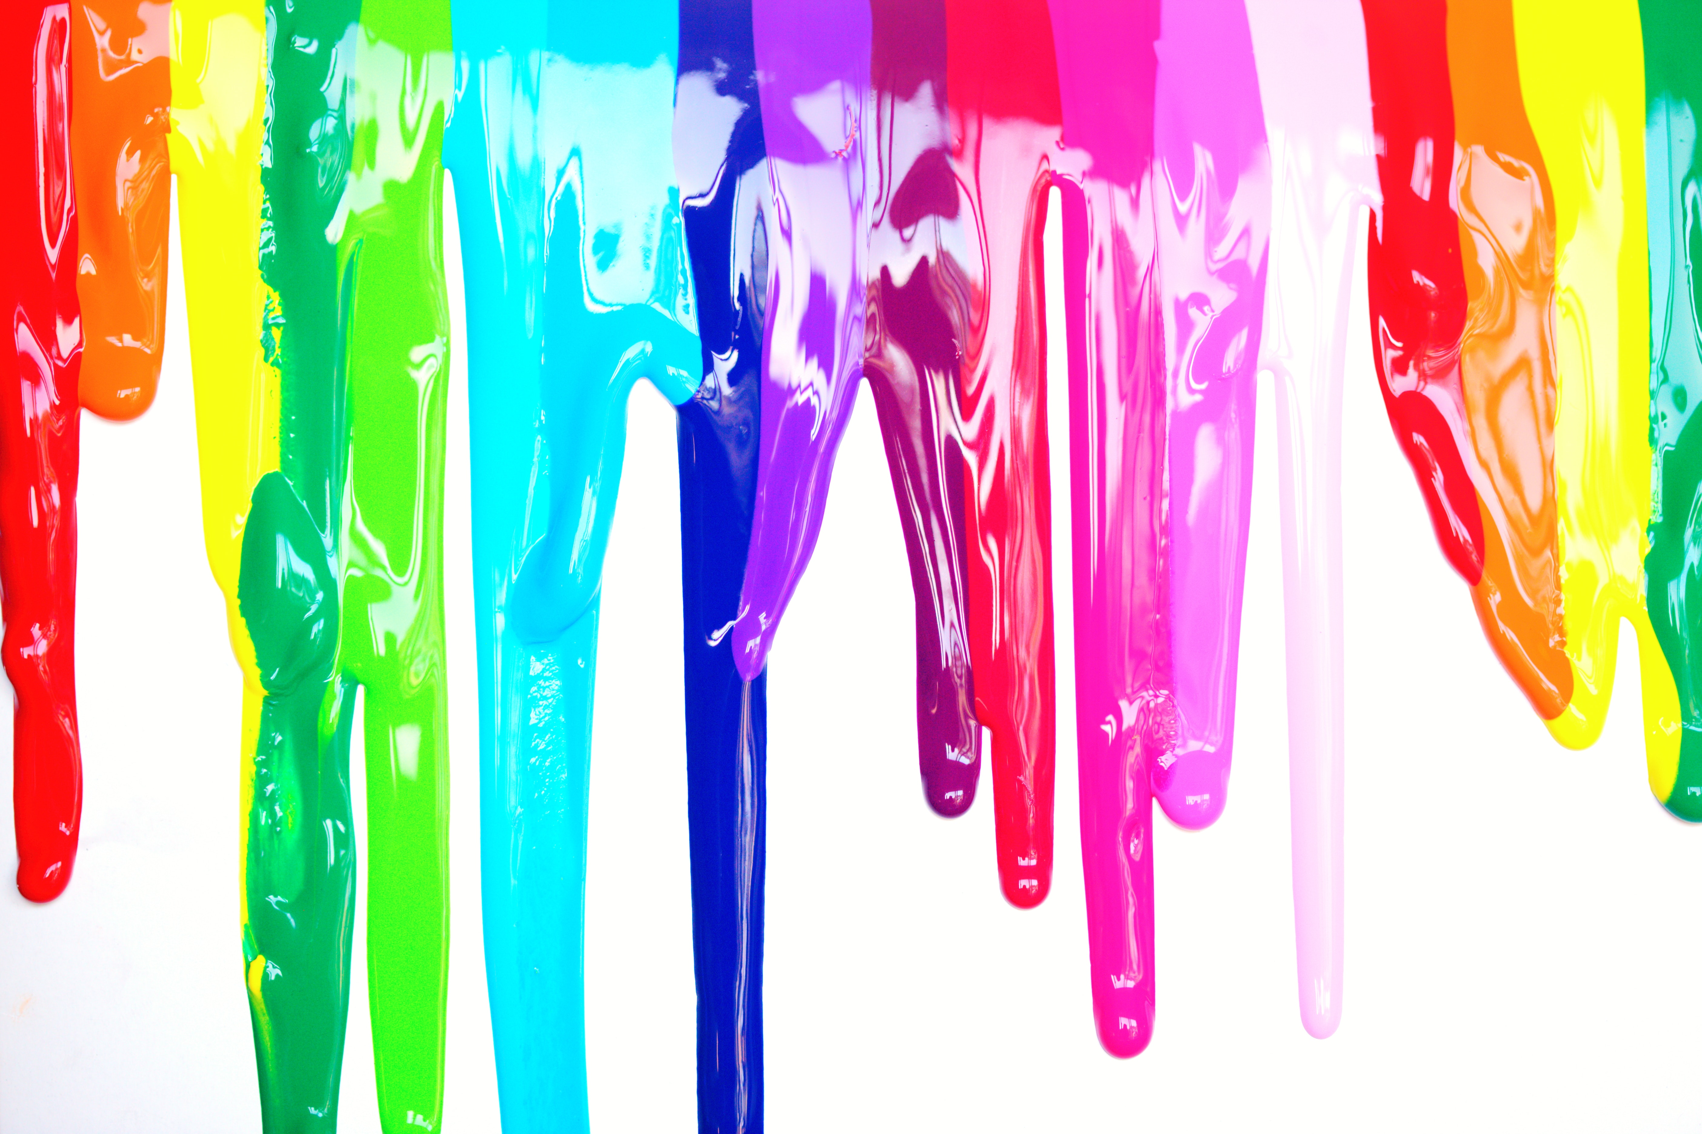
Unit 6
Suzy

Slide 3

A magic fan
What colour is the fan？
It's...
red
blue
yellow
pink
Notes:
教 red blue yellow white 准备板贴 表演魔术（两瓶水） do magic

Slide 4

Let's find
Can you find the word?
在这些颜色里藏着一个词哦，你能找到它吗？
black
black
yellow
blue
orange
orange
purple
red

Slide 5
Unit 6 Colours
Suzy

Slide 6
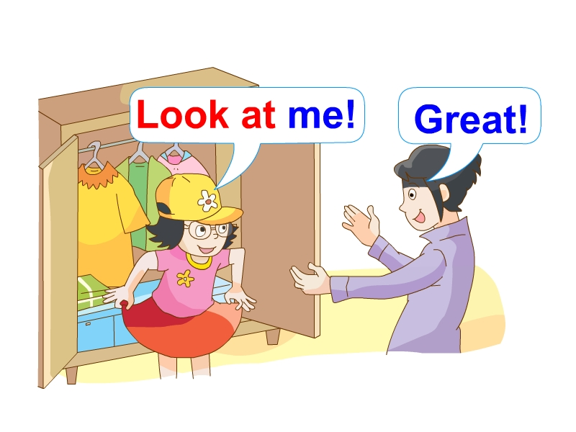
Yang Ling tries on some colourful clothes at home.
Yang Ling在家试穿一些鲜艳的衣服。

Slide 7
Pair work
What colour does she choose?
Yang Ling选择了哪些颜色呢？
两人一组，轮流问问吧
-What colour is the T-shirt/skirt/cap?
-It's...
It's=It is
Notes:
It's is equal to it is

Slide 8
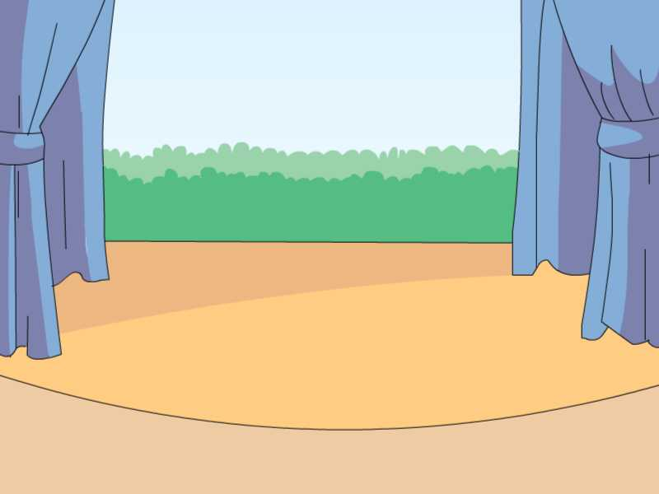

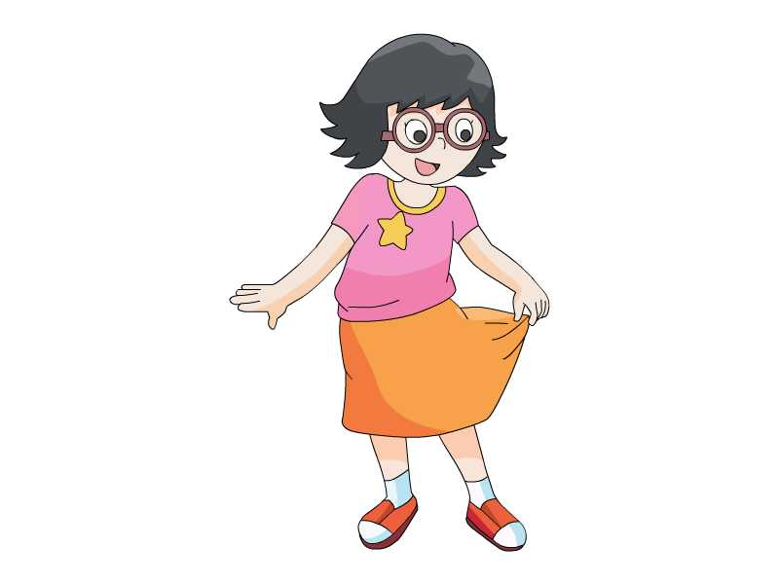
魔术表演
A magic show
What will she show for us?
Yang Ling将会为我们展示什么神奇的事物呢？
orange

Slide 9
If you are Yang Ling,how do show your skirts？
如果你是Yang Ling,你会怎么介绍呢？
Look and say
Look at my skirt.It's orange.
Notes:
跟读 朗读指导 道具表演

Slide 10
Watch and answer
What colour is Yang Ling's skirt?
看动画，记住Yang Ling的短裙有哪些颜色哦！
Notes:
Yang Ling shows different colours of skirts.

Slide 11
What colour is Yang Ling's skirt?
Yang Ling的短裙有哪些颜色呢？

Slide 12

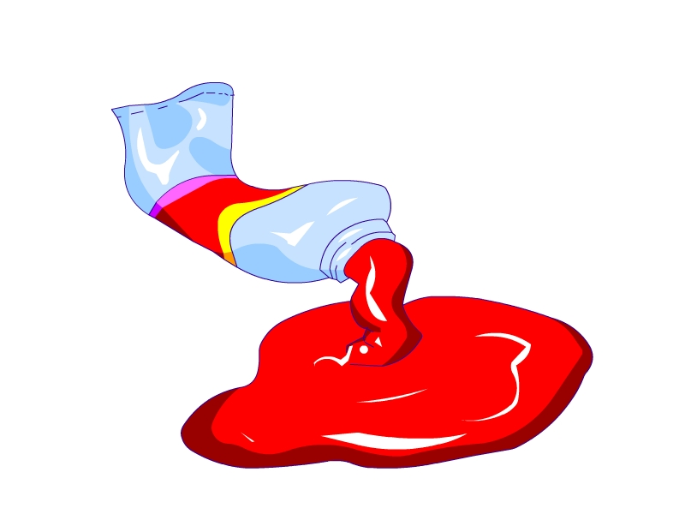



Watch and tick
√
√
( )
( )
√
√
( )
( )
( )

Slide 13





Read and order
Read the story by yourself and order the colours.
自读课文，给颜色排序。
你能按对话中的顺序给颜色排序吗？
( ) ( ) ( )
One,the skirt is...
Two,the skirt is ...
Three,the skirt is...

Slide 14
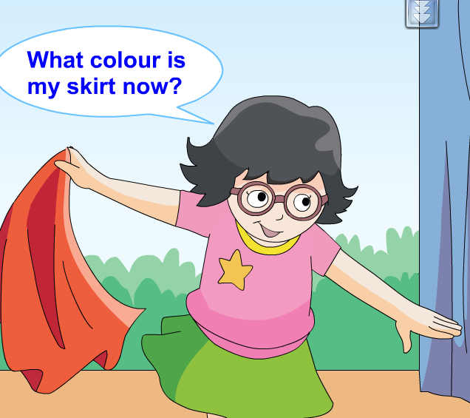
Read and say
Yang Ling是怎么询问颜色的?
now
现在

Slide 15
What colour is my skirt now?
PK time
你能清楚、流利、响亮地读吗?选一个同学比一比吧!

Slide 16

What colour is my skirt now?
It's green.
Notes:
It's green.指导朗读

Slide 17
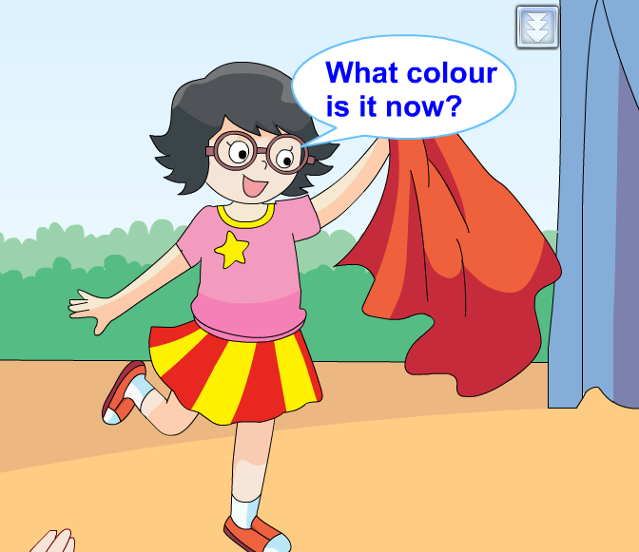
What colour is it now?
What else can they say?
他们还能说什么？
“Red and yellow” means___.
A.红色黄色
B.红黄相间
C.红黄色
B
It's red and yellow.

Slide 18
What else can they say?
他们还能说什么？
What colour is it now?
Cool!
...
Great!
How nice!o

Slide 19
Can you find the difference between them? 你能找到两句话中的不同吗？
Let's compare
my skirt
What colour is my skirt now?
What colour is it now?
PK time

Slide 20
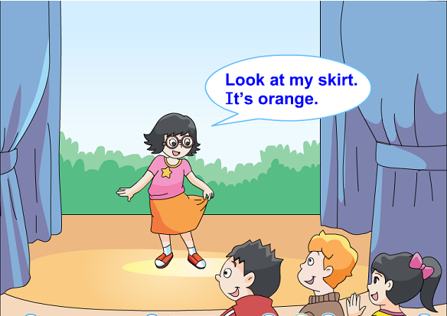
Listen and repeat
注意模仿语音语调哦！

Slide 21
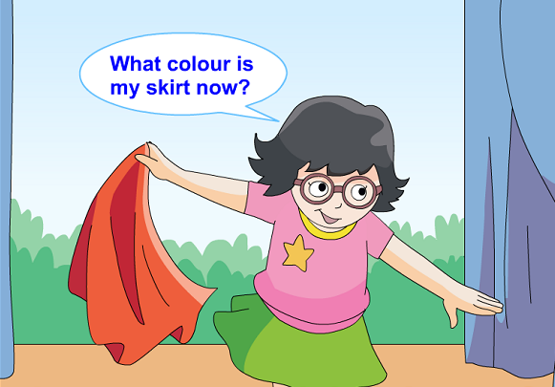
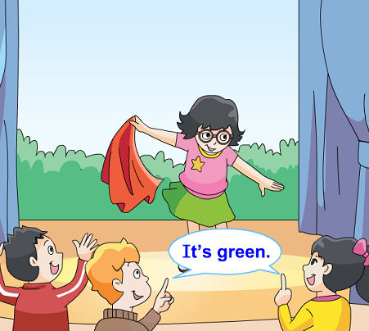
Listen and repeat
注意模仿语音语调哦！

Slide 22
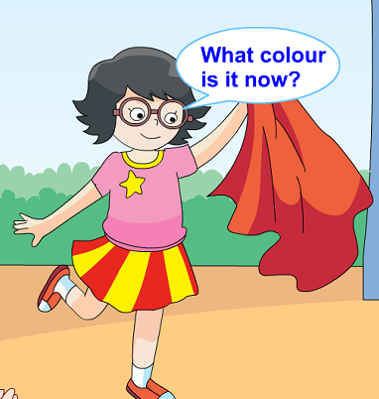
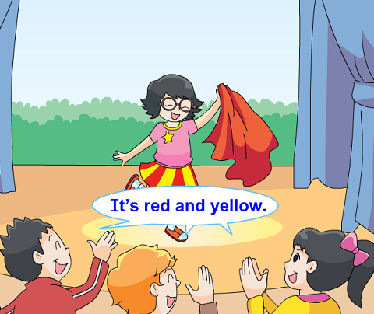
Listen and repeat
注意模仿语音语调哦！

Slide 23
Show time
Work in four.四人一组演一演。
观众可以鼓励Yang Ling哦！加上动作就更棒啦！
Useful phrases:
How nice!
It's great!
Great!I like it!
...

Slide 24

I can do it!
每一大组有一个变色酒杯道具，请每组先轮流用道具演一演，选出一位优秀魔术师代表和三名观众代表上台，魔术师注意表演技巧和舞台效果，观众注意要捧场哦！
^{Useful phrases:}
Magician(魔术师)：Look at the wine glass.What colour is it?
^{Audience(观众)：It's ...}
Magician(魔术师):What colour is it now?
Audience(观众)：Great/How nice...It's...
Magician(魔术师):What colour is it now?
Audience(观众)：Cool/Amazing...It's...
^{Magician(魔术师)：Thank you!}

Slide 25

Colours are Magic!
颜色是神奇的！

Slide 26
Colours are beauitful!
颜色让生活更美好！

Slide 27
Homework
1.Listen to the tape and read story time five times.
听录音，朗读story time5遍。
2.Talk about colours in your life.
用英语说说身边物品的颜色。

