Slide 1
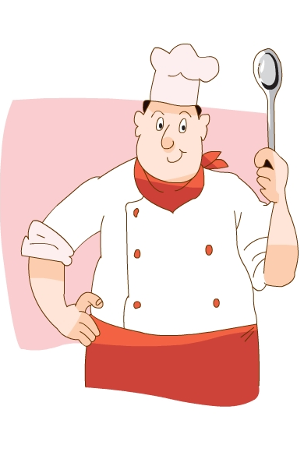
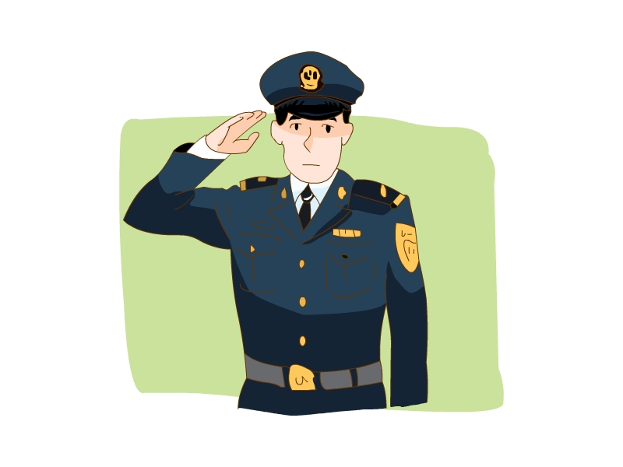
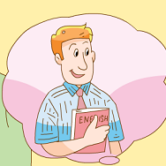
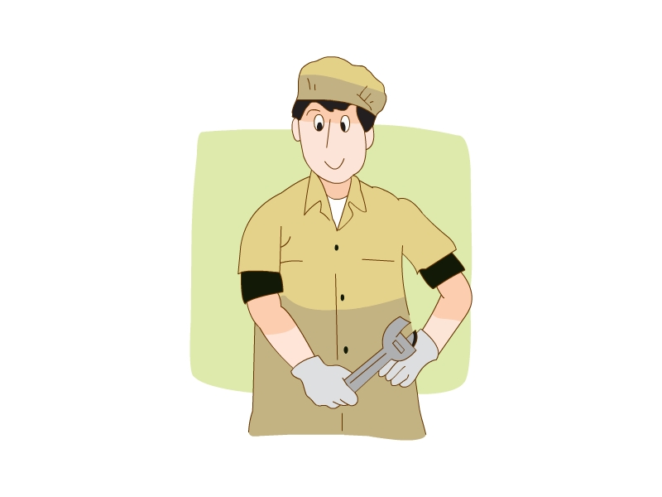
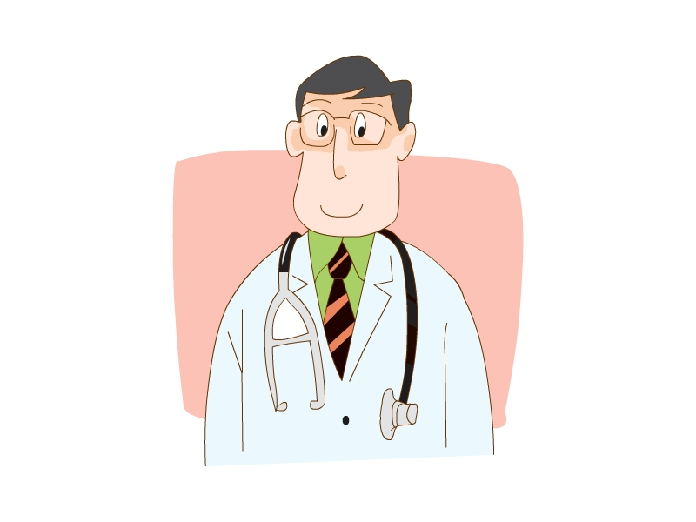
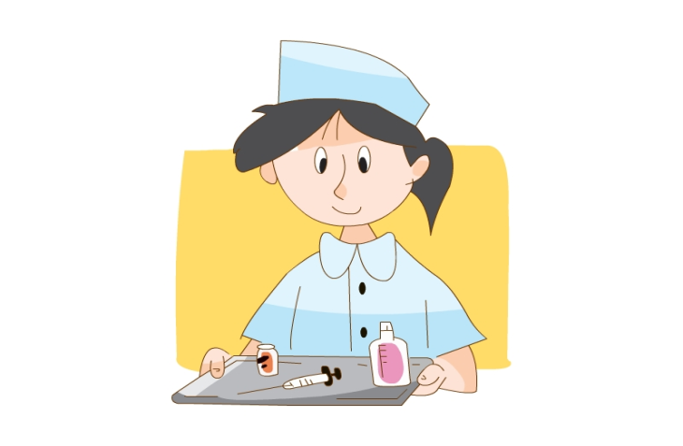
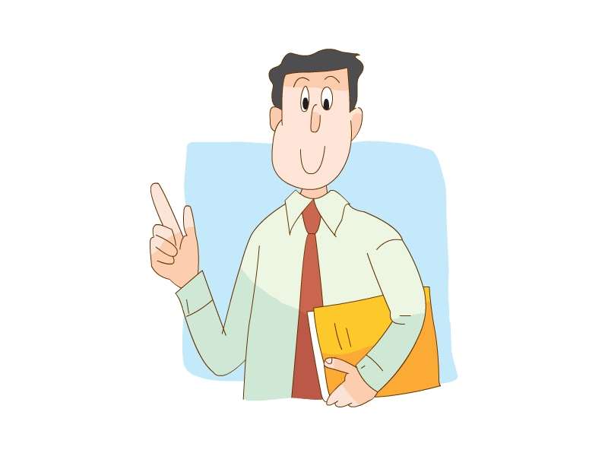
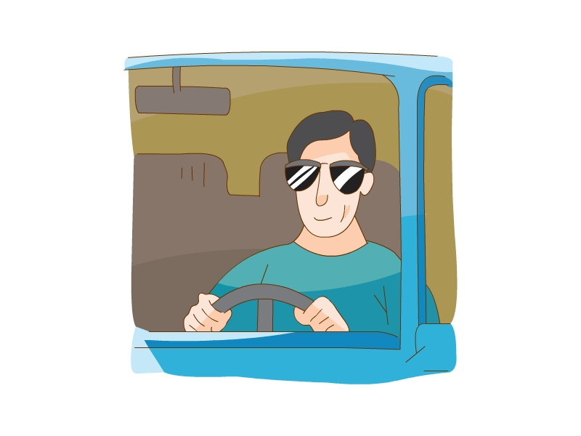
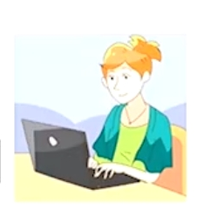
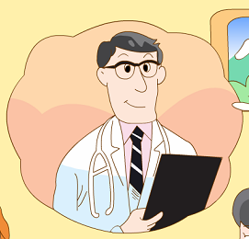
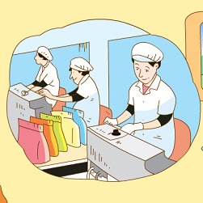
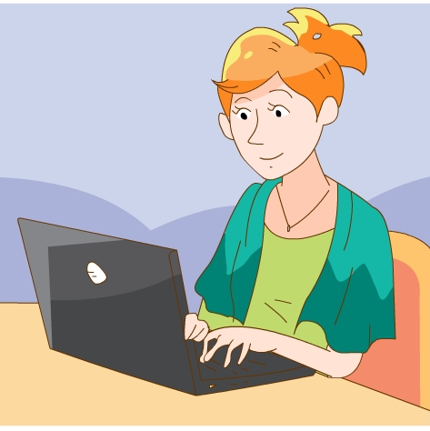
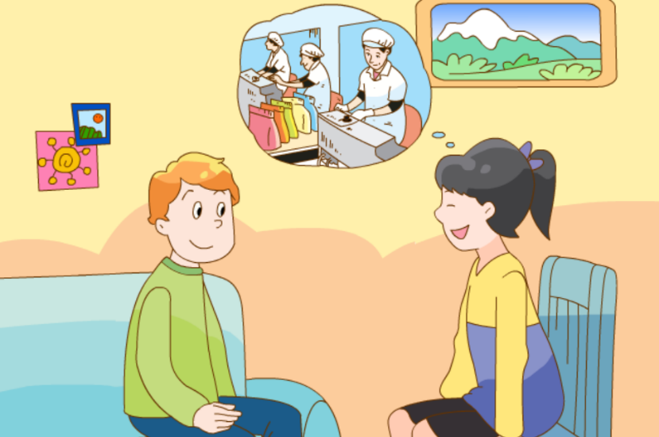
Unit 5
What do they do?
doctor
doctor
doctor
writer
writer
writer
Unit 5
What do they do?
Unit 5
What do they do?
What does he do?
jobs
worker
worker
worker
What does ... do?
What does he do?
He’s a...
teacher
cook
He’s a...
teacher
cook
He’s a...
teacher
cook
nurse
farmer
farmer
driver
driver
She’s a...
driver
She’s a...
She’s a...
farmer
policeman
farmer
policeman
farmer
policeman

