Slide 1
Unit 8 At Christmas
Story time(第一课时)

Slide 2



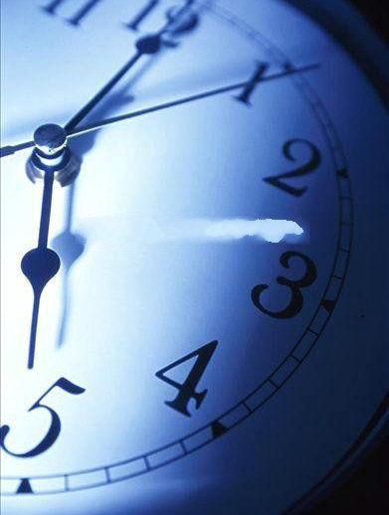
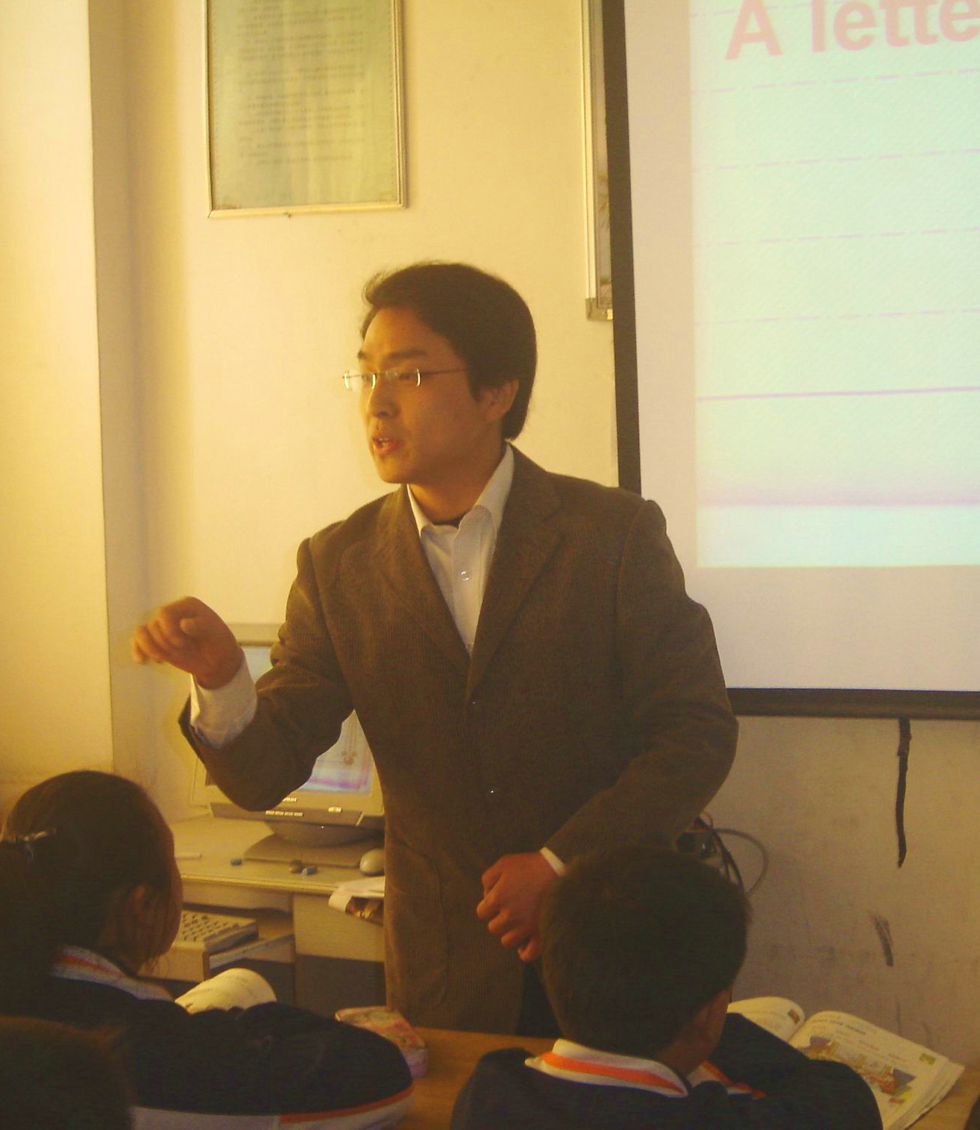
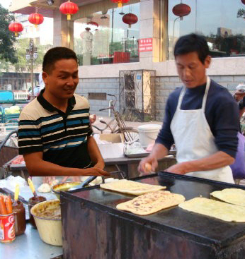
Get to know
Miss Liu
early
I wake up early everyday.
First, I buy breakfast.
buy
Next, I go to school.
Then, I give lessons.

Slide 3
What do I do every day?
You wake up early everyday.
First, you _______________.
buy breakfast.
Next, you _______________.
go to school.
Then, you _______________.
give lessons.

Slide 4


Then
Finally
First
Next
Finally, evening comes,
I listen to music, read stories
…
Let’s wait and see.

Slide 5







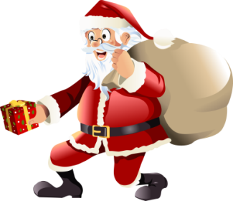






Slide 6
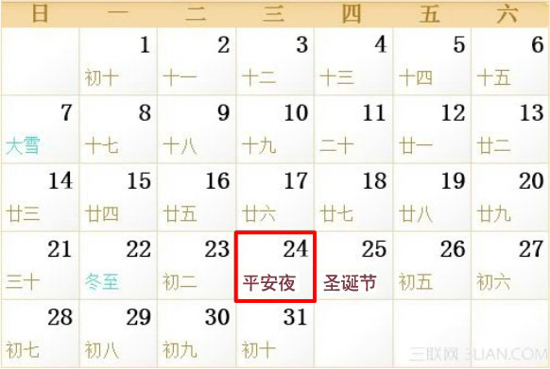

Before Christmas
Christmas Eve
Christmas Day
Father Christmas
Who is he?
When does he come?

Slide 7


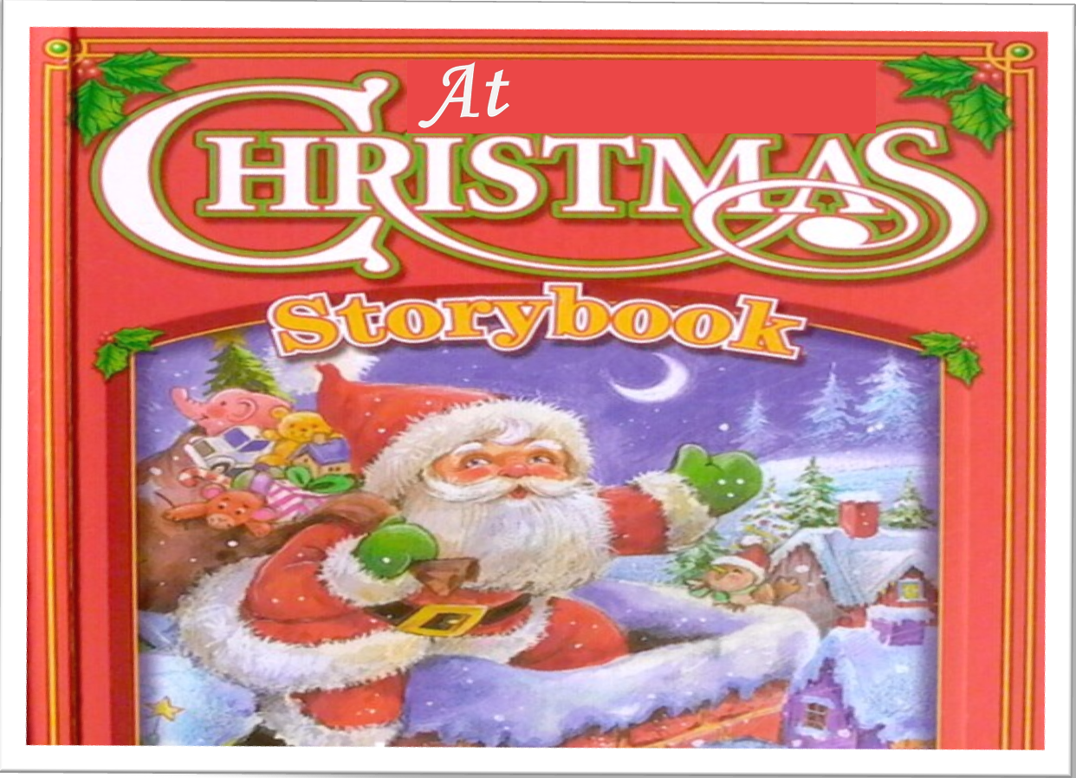



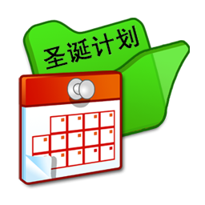

First Let’s watch
Next Let’s learn
Then Let’s retell
Finally Let’s plan

Slide 8
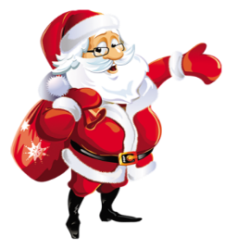
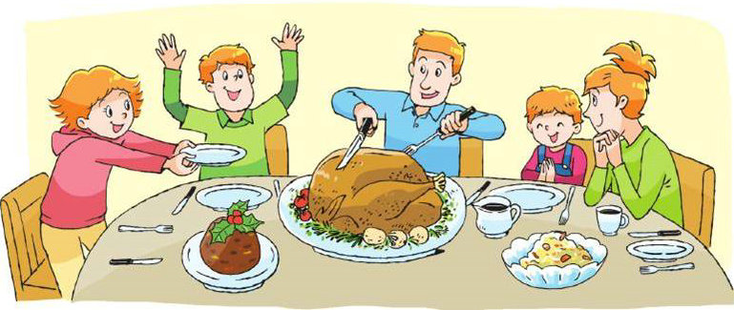
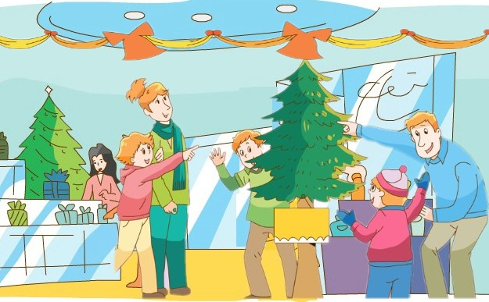
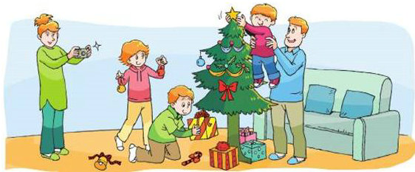
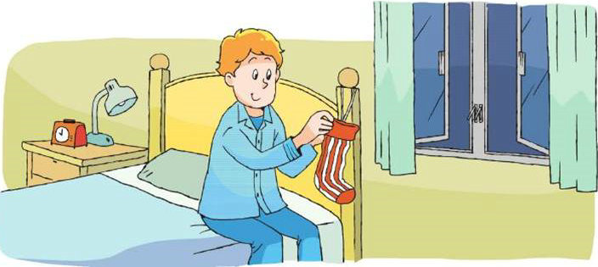
First
Let’s watch
Before Christmas
12月24日
Christmas Eve
Who are they?
What do they do?
12月25日
Christmas Day
仔细观看卡通，找出视频中与左侧时间相对应的场景图片！

Slide 9


Slide 10
Choose pictures
A.
Before Christmas
B.
12月24日
Christmas Eve
C.
12月25日
Christmas Day
D.

Slide 11


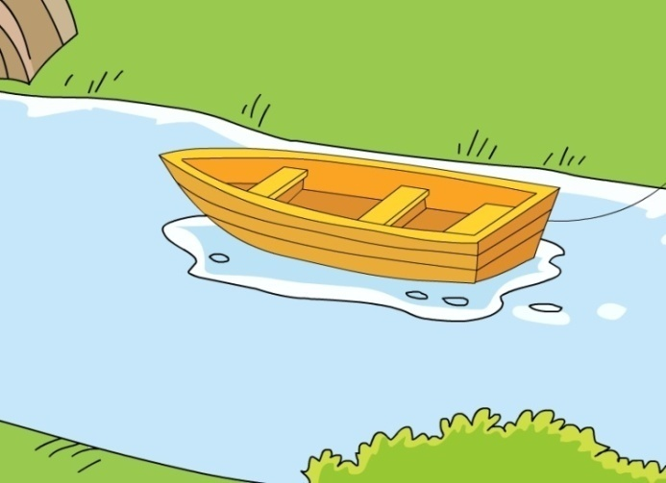
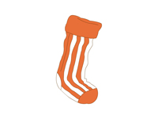


Next
Let’s listen and tick（图1、2）
What do they do before Christmas?
1）They buy .
2）They put pretty things the Christmas tree.
in
on
under
3）They put their presents the tree.
in
on
under
What else do they do before Christmas?

Slide 12
First, we buy presents for our family and friends.
We also buy a Christmas tree.
We sometimes go to see father Christmas.

Slide 13
Next, we put some pretty things on the Christmas tree.
We also put our presents under the tree.
It looks great.

Slide 14
Read and answer(图3)
Then, Christmas Eve comes. We put a stocking on our beds and wait for presents
stocking
sock
What do children do on Christmas Eve?

Slide 15
Read and complete
Finally, it is ! We early and our present. We have a lunch. We a turkey and Christmas pudding. We all have a good time!
Christmas Day
wake up
open
big
eat
turkey
pudding
put

Slide 16

boring
乏味的
wonderful
They always have a lot of fun
at Christmas.
Christmas
nice
funny
busy
interesting

Slide 17



Happy reading
选择你喜欢的朗读方式
小组内一人领读，其余人跟读
分段朗读
小组成员一起齐读

Slide 18
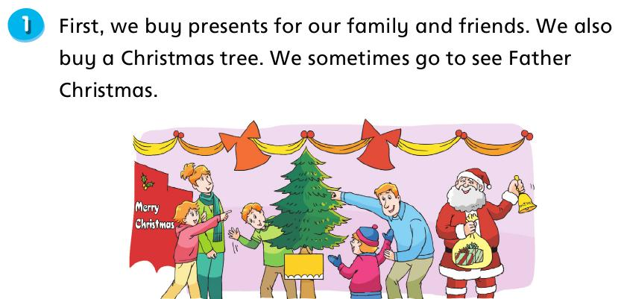
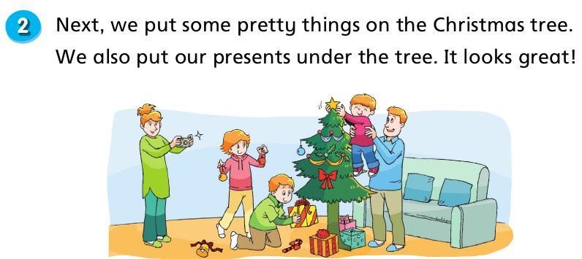
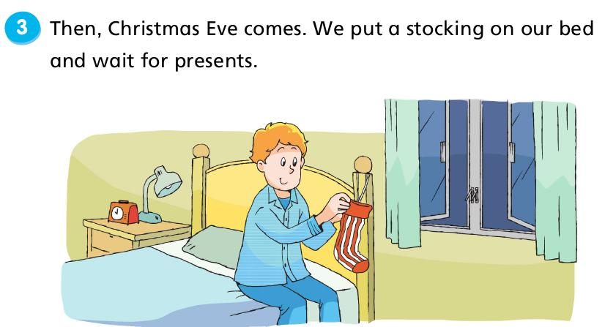
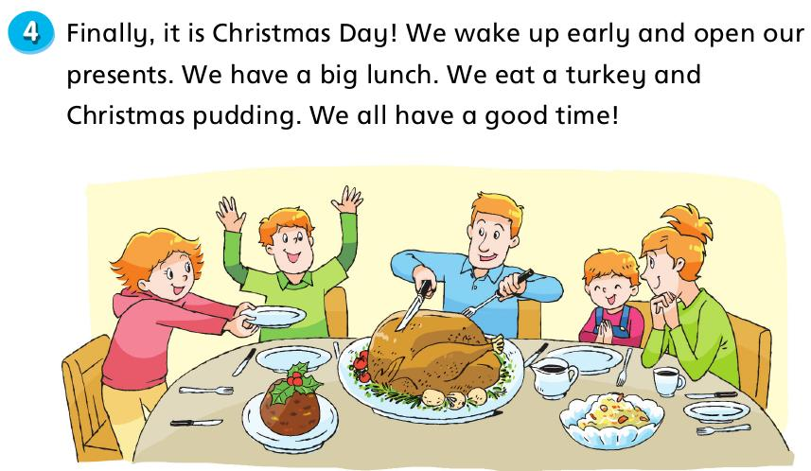
要求：大声读，争取做到正确、流利。

Slide 19
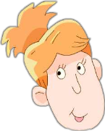
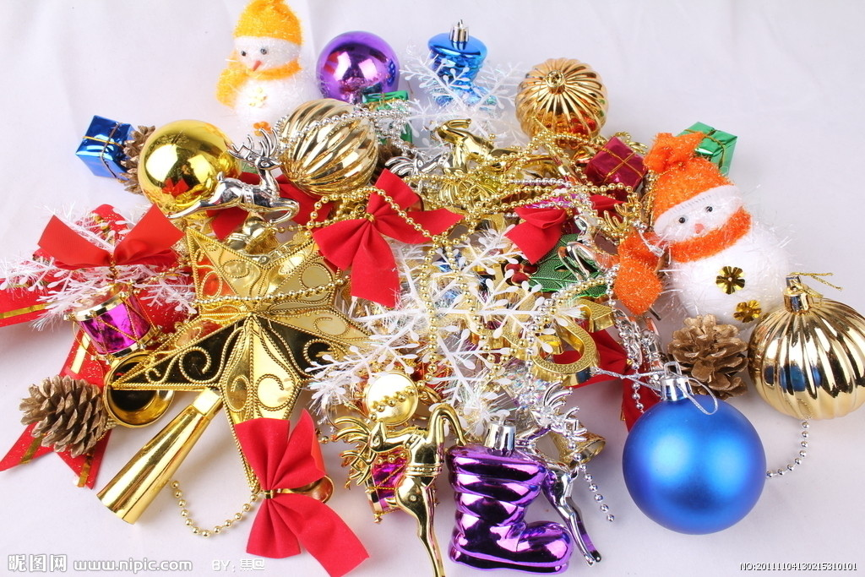
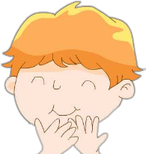



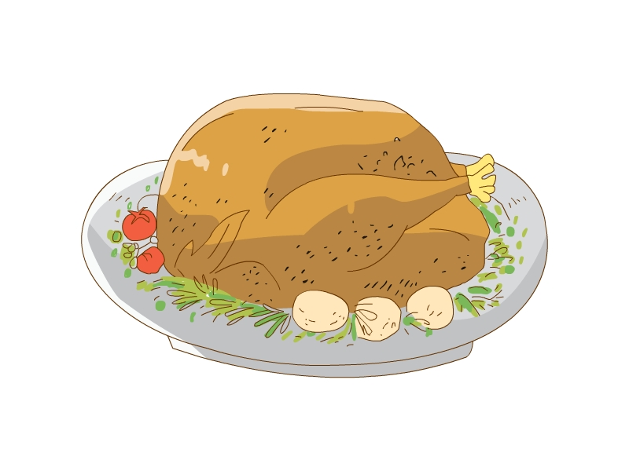
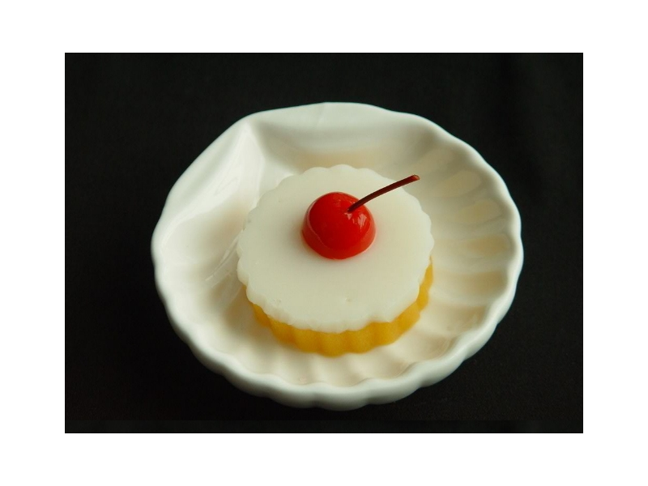
Then
Let’s retell
Before Christmas
Before Christmas，we buy … and …, Sometimes we …
Next ，we put … we also put
Then , Christmas Eve comes, we put … and …
Finally, it is Christmas Day, we … early and open …
We eat …
We have a lot of fun at Christmas

Slide 20
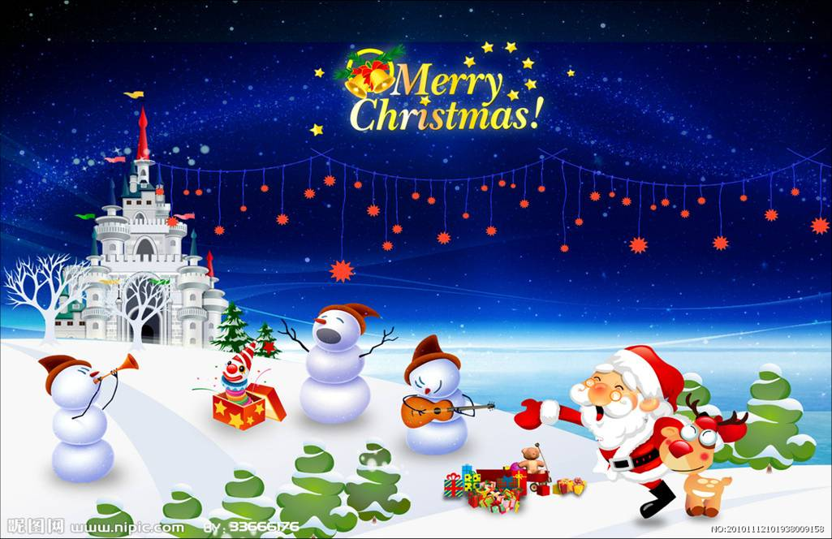
Finally
Let’s plan
What do you do at Christmas?

Slide 21
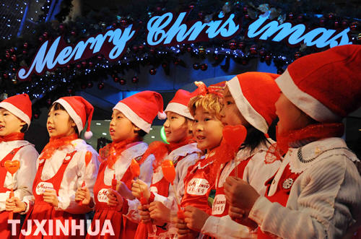
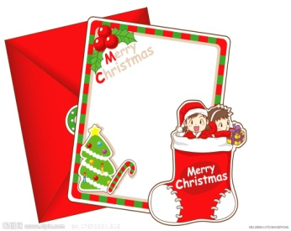
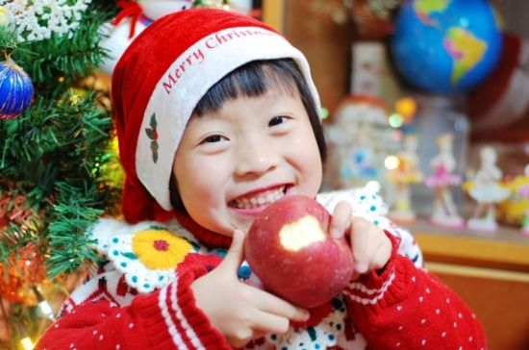
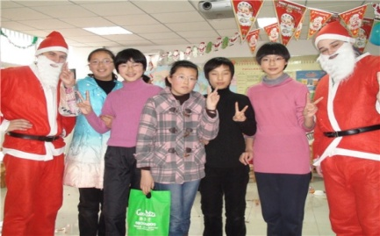
Miss Liu’s Christmas plan（计划）
First, we sing some Christmas songs.
Next, we make cards（贺卡） for our family and friends.
Then, Christmas Eve comes. We eat apples for a good wish.
Finally, it is Christmas Day! We have a Christmas party!

Slide 22
Make a Christmas plan.
（制定圣诞计划）
Tips:
1.Key words（关键词）:
first, next, then, finally
2.Discuss together, then write down
First, ______________________.
Next, ______________________.
Then, ______________________.
Finally, _____________________.

Slide 23
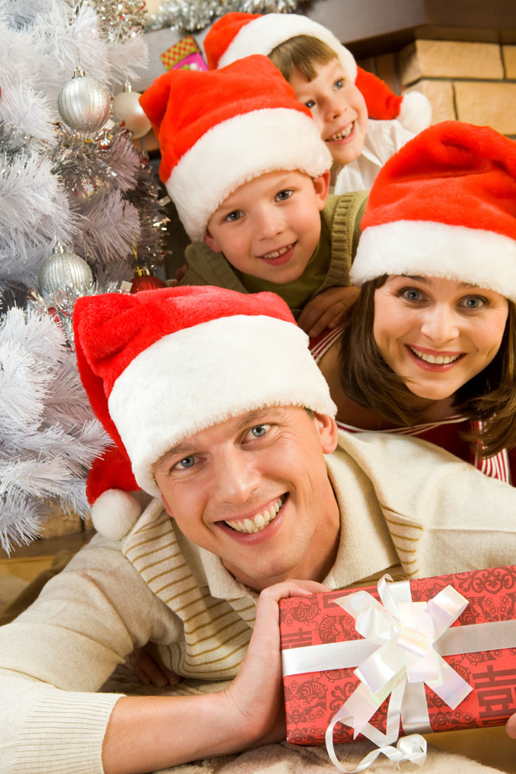
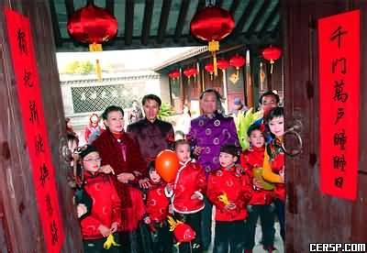
Christmas Day is popular in Western countries.
Spring Festival is popular in China.
Homework:
1. Surf the Internet to know more about Christmas.
2. Think about the difference between Christmas
and Spring Festival.

Slide 24
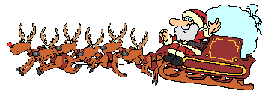
Goodbye!
See you soon!

