Slide 1
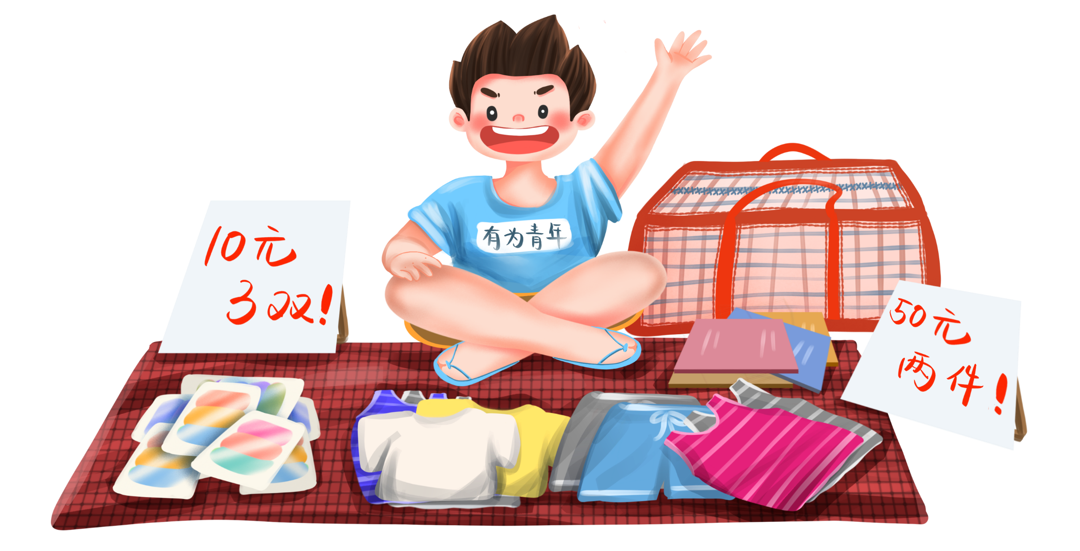
Unit 7 How much?
（Story time）
义卖
义卖

Slide 2
Sing with the song跟着歌曲唱一唱。

Slide 3
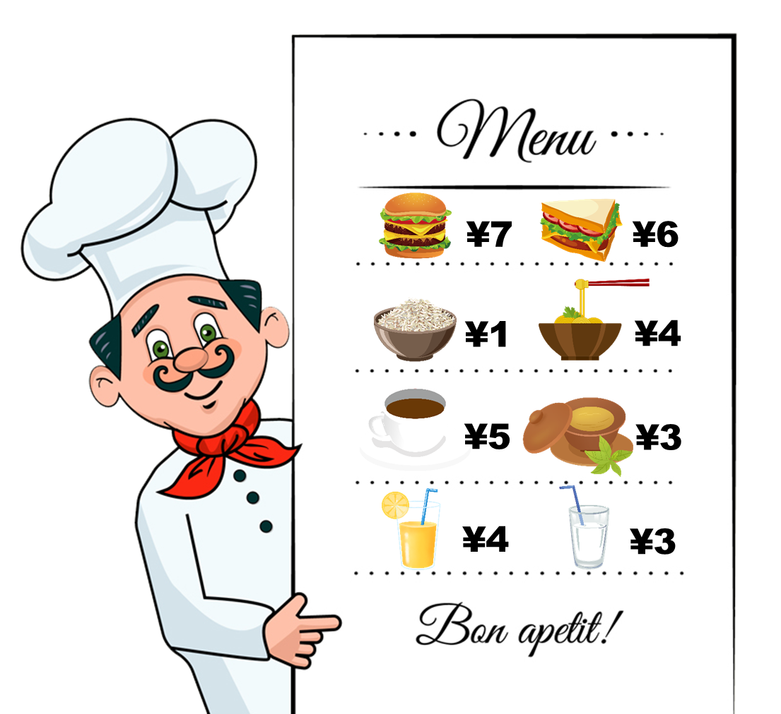
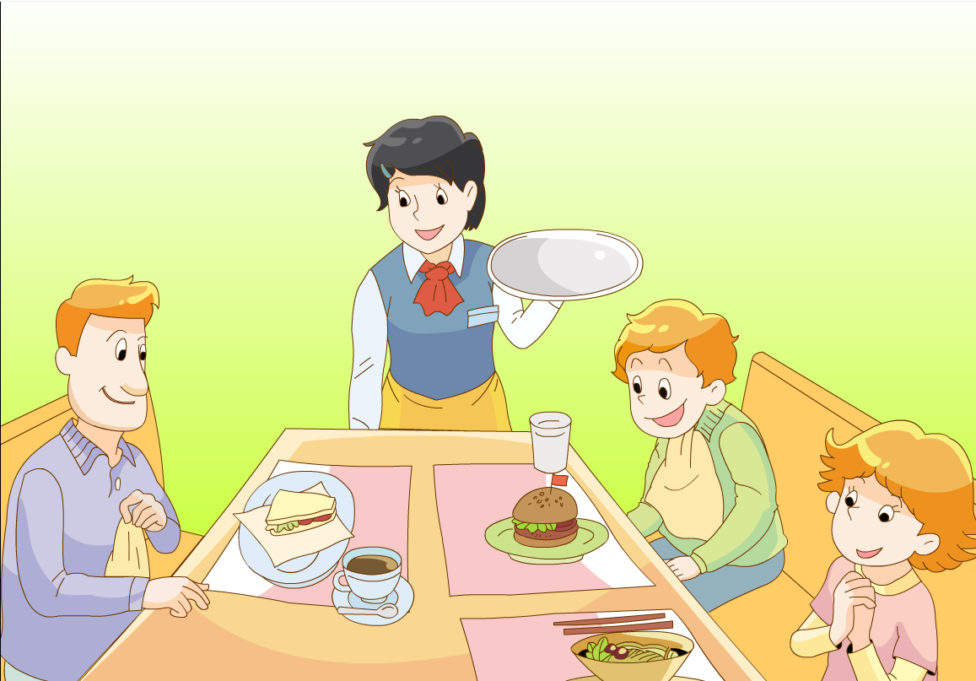
Let’s review: What would they like?
Mr Green would like...
Mike would like...
Helen would like...

Slide 4
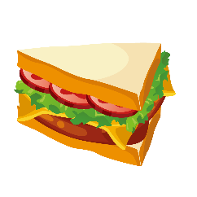
How much is it? It’s...yuan.
How much are they? They’re...yuan.
¥7
¥6
¥1
¥4
¥5
¥3
¥4
¥3
?

Slide 5
Let’s chant
Hamburger, hamburger. How much is it?
¥7
¥12
Seven yuan, seven yuan. It’s seven yuan.
Noodles, noodles. How much are they?
¥1
¥4
Four yuan, four yuan. They are four yuan.
¥5
¥3
¥4
¥10

Slide 6
Make a chant
两人一组，一问一答。制作一个新chant.
_____, _____. How much is it?
¥7
¥12
___yuan, ___yuan. It’s____ yuan.
____,____. How much are they?
¥1
¥4
___ yuan,___ yuan. They are ___ yuan.
¥5
¥3
¥4
¥10

Slide 7
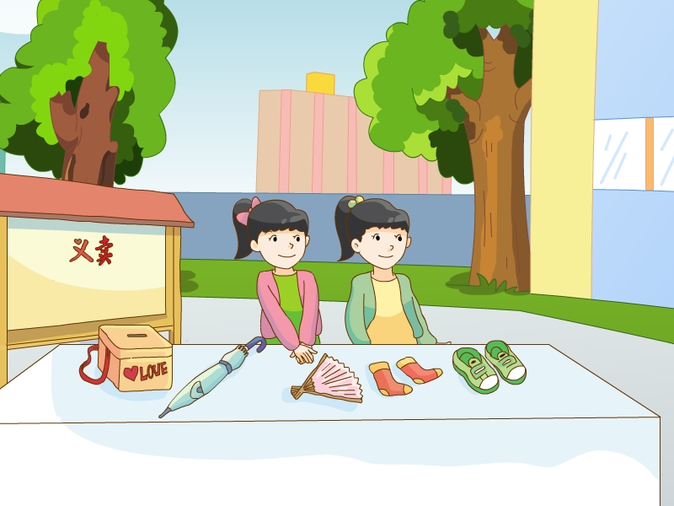

Slide 8
Look and say: What do they sell（卖）?
can
clock
an umbrella
a fan
socks
shoes

Slide 9
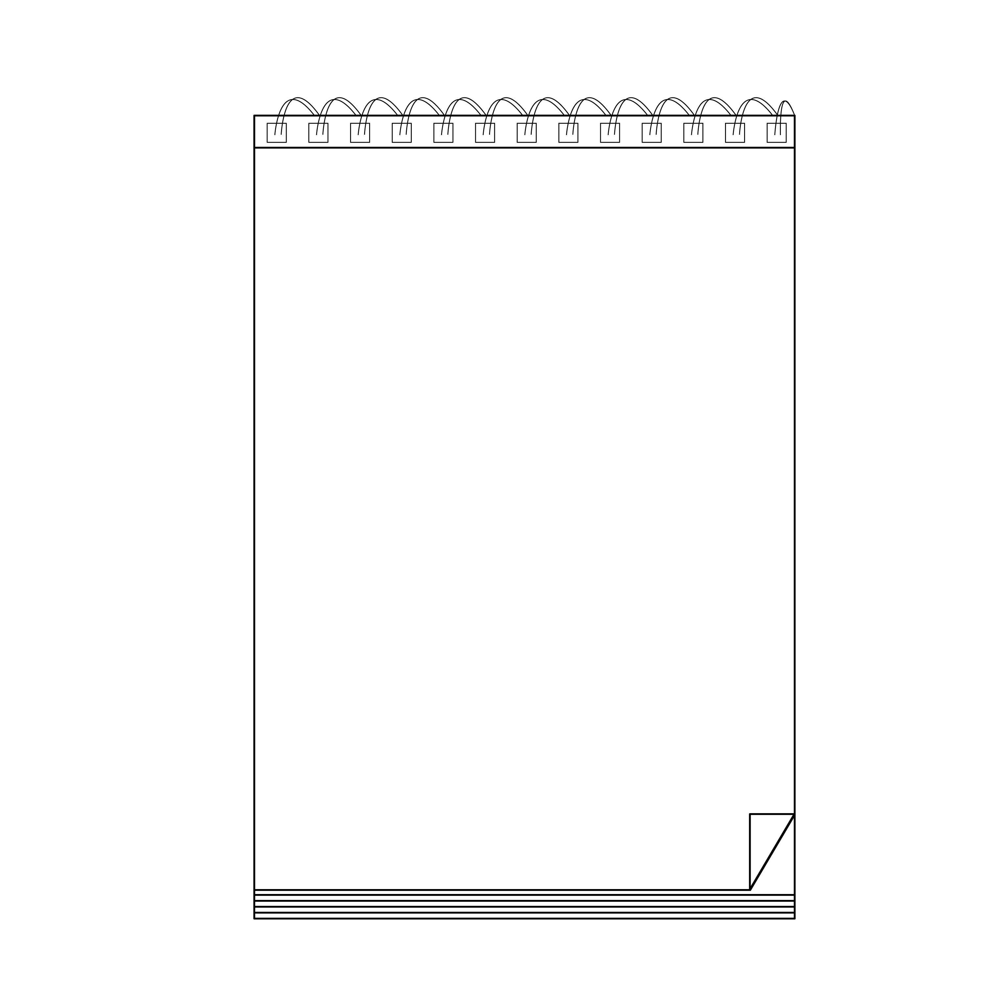
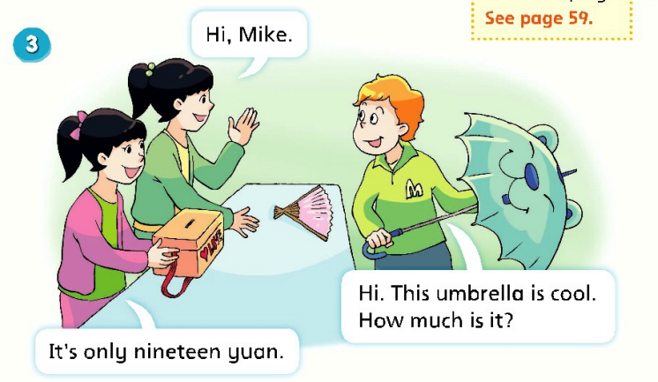
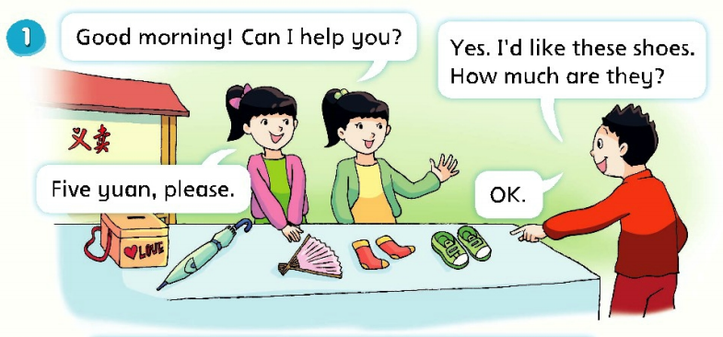
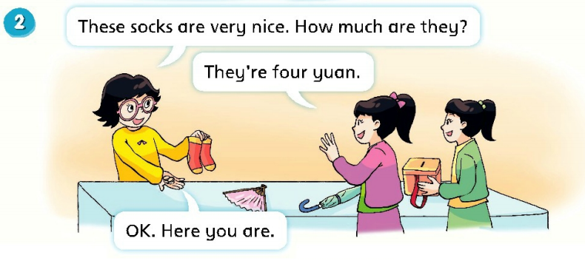
Look and find
Who are the customers（顾客）?

Slide 10
Who are the customers（顾客）?

Slide 11
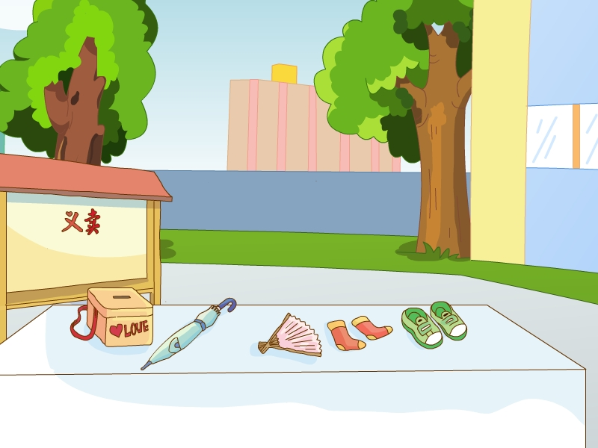
Watch and choose: What would they like?

Slide 13
Watch and choose
Liu Tao would like...

Slide 14
Watch and choose
Why（为什么） would Yang Ling like these socks？
Yang Ling would like...

Slide 15
Watch and choose
Why would Mike like this umbrella?
Mike would like...

Slide 16
Read and fill
阅读课文，在你的书上划出答案
How much are the shoes?
They’re...
Who?
What?
How much?
five yuan

Slide 17
Read and fill

Slide 18
Read and fill
阅读课文，在你的书上划出答案
How much are the socks?
They’re...
Who?
What?
How much?
five yuan
four yuan

Slide 19
Read and fill

Slide 20
Read and fill
阅读课文，在你的书上划出答案
How much is the umbrella?
It’s...
Who?
What?
only
nineteen yuan
（仅仅，只有）
How much?
five yuan
four yuan

Slide 21
Read and fill

Slide 22
Read and fill
阅读课文，在你的书上划出答案
Su Hai和Su Yang最后得到了多少钱？
Who?
What?
only
nineteen yuan
（仅仅，只有）
How much?
five yuan
four yuan

Slide 23
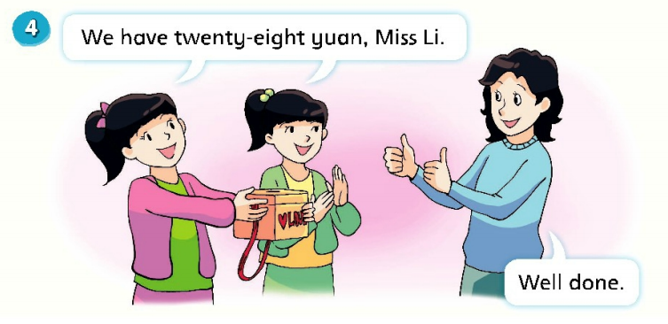
Look and say
How do they feel now?（他们现在感觉怎么样？）
happy
excited
（激动的）

Slide 24
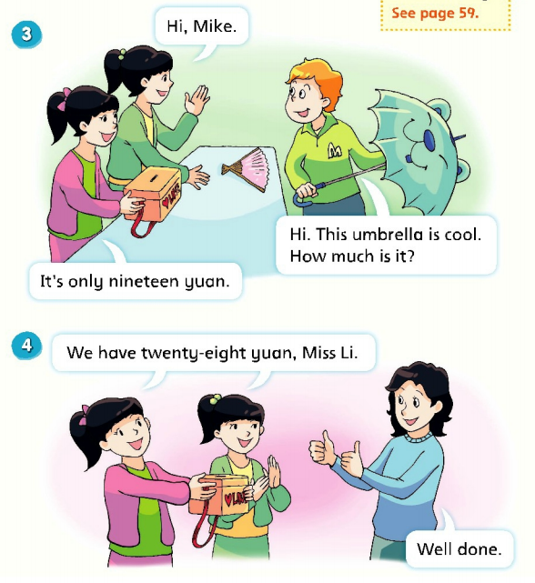
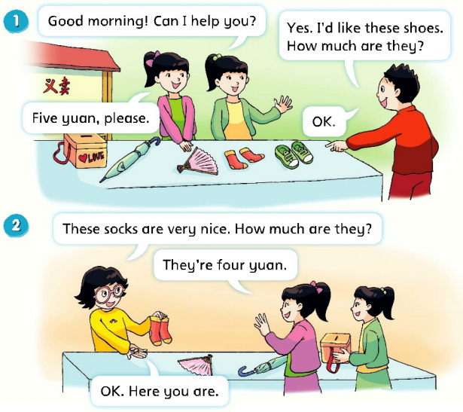
Listen and repeat

Slide 25
Read in groups (小组齐读）
比一比哪一组声音最响最亮！

Slide 26
Act it out（6人一组进行表演）

Slide 27
Summary
seller卖方
A
D
A: Can I help you?
B: What would you like?
C: How much is it?
D: It’s... yuan.
E: How much are they?
F:They’re...yuan.
G:This...is very cool.
H: They’re very nice.
B
F
customer顾客
C
E
G
H

Slide 28
Why do they have a charity sale?
（他们为什么要举办义卖活动？）

Slide 30
If everyone presents a bit of love, the world will become a wonderful world.
（只要人人都献出一点爱，世界将变成美好的人间）

Slide 31
Homework
Listen, read and recite Story time.
Preview Cartoon time and Fun time.
（听读并背故事时间）
（预习卡通和趣味时间）

